Slide 1

Guided computational practical:
Genes and Genomes
Masue Marbiah, PhD
07/10/2024

Slide 2
Overview
1 | Reference Genomes
2 | Genome Annotation
3 | Genome Browsers
4 | Gene Structure
5 | CRISPR Design Process and Tools
6 | Other sgRNA Design Tools

Slide 3
Reference Genomes
Notes:
The first step when designing a CRISPR project is typically a decision about which gene to target, and which host or genome to use in the study. In this section we will look at reference genomes, where to find them and the content of these databases, with a particular focus on gene structures.
By a show of hands, how many people have a preferred organism/genome that they are working on? And how many people are interested in human or mouse genomes?
As we will see later, all gene editing resources are dependent on reference genome assemblies, therefore it is crucial to understand how to navigate data found in reference genomes in order to properly design your experiment.

Slide 4

Reference genomes
Genome Reference Consortium
Consortium goals:
Maintain reference genomes
Correct regions in the genome that are currently misrepresented
To close as many genomic gaps as possible
Scientific community can report loci in need of review
Genome Reference Consortium releases include major and minor updates (patches).
For example, Genome Reference Consortium human 38 patch 14 (GRCh38.p14)
Equivalent gene builds for mouse, rat, zebrafish and chicken are also available.
https://www.ncbi.nlm.nih.gov/grc
Notes:
One of the major repositories for genome sequences is produced and maintained by the Genome Reference Consortium.
Wellcome Sanger Institute, The McDonnell Genome Institute at Washington University, The European Bioinformatics Institute, The National Center for Biotechnology Information, The Zebrafish Model Organism Database and Rat Genome Database

Slide 5

Reference genomes
Telomere-to-Telomere Consortium
Telomere-to-Telomere (T-2-T) Consortium completely sequenced the entire human genome (no gaps) in 2022.
High quality telomere-to-telomere assemblies from diploid human genomes.
Y-chromosome was fully sequenced for the first time in 2023 providing genetic insight into how it influences male development and health.
Contribute towards the Human Pangenome Project, to generate 350 high quality gapless human genome sequences from ancestrally diverse people.
Notes:
T-2-T is a collaboration of scientists across universities and government research institutions. They have fully sequenced the 3 billion nucleotides that make up the human genome.

Slide 6
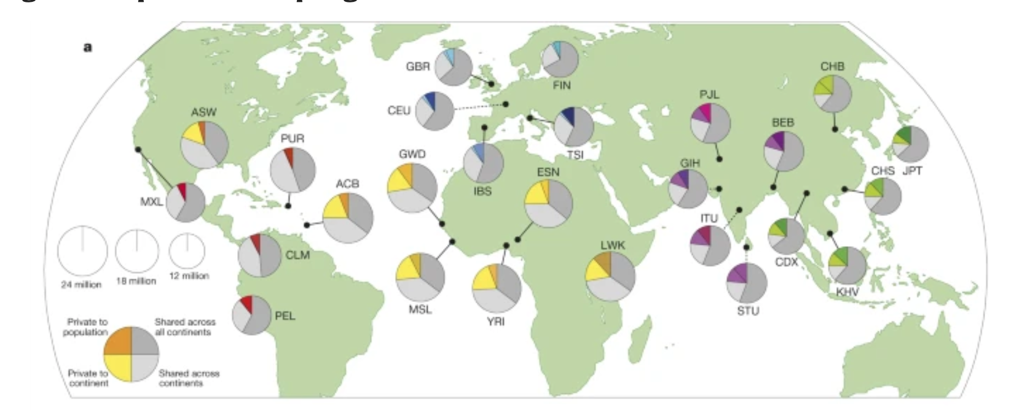
Reference genomes
The 1000 Genome Project
The goal of the 1000 Genomes Project was to find common genetic variants with frequencies of at least 1% in the populations studied.
Genomes of 2,504 individuals from 26 global populations were studied. The consortium identified >88 million variants (SNPs, InDels and structural variants). Variants molecular and disease phenotypes.
Nature 526, 68–74 (2015).
Notes:
The 1000 genomes project was completed in 2015. The project received further funding to create the international genome sample resource. This allows continued maintenance (and analysis) of the genomic DNA samples, further sample collection and sequencing (particularly as techniques are cheaper and more sensitive.

Slide 7
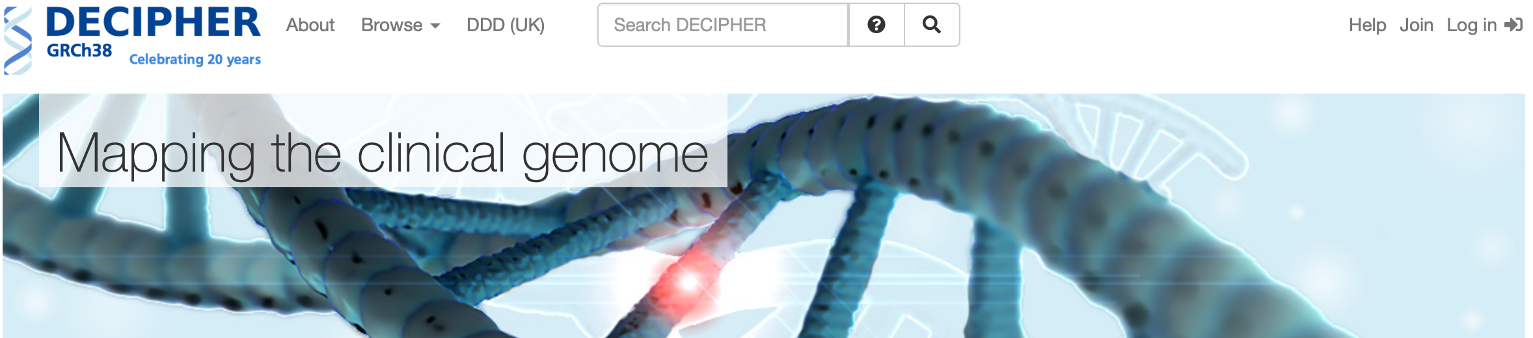
Reference genomes
DECIPHER
DECIPHER (DatabasE of genomiC varIation and Phenotype in Humans using Ensembl Resources) is an interactive web-based database which incorporates a suite of tools designed to aid the interpretation of genomic variants found in rare diseases.
Data from over 270 centres reporting on >36,000 cases are publicly available with patient consent.
This dataset includes the DDD (Deciphering Developmental Disorders) study, which has recruited ~ 14,000 children with severe undiagnosed developmental disorders, and their parents from around the UK and Ireland.
Notes:
P31 of notes
DECIPHER enhances clinical diagnosis by retrieving information from a variety of bioinformatics resources relevant to the variant found in the patient. The variant is then viewed in the context of both normal variation and pathogenic variation reported at that locus thereby facilitating interpretation.

Slide 8

Reference genomes
Mouse Genome Project
The Mouse Genomes Project is an ongoing effort to catalogue all forms of genetic variation between the common laboratory mouse strains and to produce high quality annotated reference genomes for the key strains.
>50 strains including BALB/c and C57BL/6
Project focuses on:
Short-sequencing reads of many lab strains to identify variants relative to C57BL/6
Generate reference genomes and strain specific annotations of the commonly used strains.
Notes:
The mouse genome was derived from an inbred mouse strain, which means that there are significant differences to other common inbred mouse strains used in the laboratory.

Slide 9
Genome Annotation
Notes:
Genome annotation is the process of finding and designating locations of individual genes and other features on raw DNA sequences, called assemblies. Annotation gives meaning to a given sequence and makes it much easier for researchers to view and analyse its contents.
P5 of notes. Gene annotation typically defines genes and transcripts, but it can also include other transcript features, such as transcription start sites (TSS) or polyadenylation (polyA) sites. The main reference gene sets are GENCODE for human and mouse.

Slide 10

Gene Annotation
Databases
GENCODE
High quality reference gene annotation and experimental validation for human and mouse genomes, based on manual annotation that includes Ensembl annotation.
Data is primarily based on mRNA, Expressed Sequence Tags (EST) and protein evidence that is aligned to a reference genome.
GENCODE Accessions are:
 | Human | Mouse
Gene (G) | ENSG00000012345 | ENSMUSG00000012345
Transcript (T) | ENST00000012345 | ENSMUST00000012345
Exon (E) | ENSE00000012345 | ENSMUSE00000012345
Protein (P) | ENSP00000012345 | ENSMUSP00000012345
Notes:
P6 of note
The accession number is a unique identifier assigned to a record in sequence databasess.

Slide 11
Gene Annotation
Databases
RefSeq (transcript-centric)
RefSeq transcript and protein records are generated by several processes including:
Computation (mRNA XM_123456; Protein XP_123456; RNA XR_123456
Manual curation (mRNA NM_123456; Protein NP_123456; RNA NR_123456)
Annotation includes 392 eukaryotic genomes.
Ensembl (genome-centric)
Computational alignment-based annotation, including cDNAs, proteins and RNA-seq reads for over 70 different vertebrate species.
MANE (Matched Annotation between NCBI and Ensembl)
Collaborative project that aims to provide a minimal set of matching RefSeq and Ensembl transcripts of human protein-coding genes.
MANE displays:
MANE Select: One high quality representative transcript per protein-coding gene. Supported empirically.
MANE Plus Clinical: Additional transcripts with relevant “Pathogenic (P)” or ”Likely pathogenic (LP)” variants.
MANE: All other matched transcripts.
Notes:
MANE: matched pair are identical (5’ UTR, coding region and 3’ UTR), but retain their respective identifiers. P7 of notes

Slide 12
Gene Annotation
Biotypes
terms used to classify genes or transcripts.
Ensembl
sense_intronic, sense_
overlapping
snoRNA
sRNA
pseudogene
vaultRNA
rRNA
snRNA
pseudo[gene]
Protein-coding
rRNA
snRNA
macro_lncRNA
lincRNA
RefSeq
Gencode
antisense
miscRNA
tRNA
Protein-coding
snoRNA
ncRNA
3prime_overlapping_ncrna

Slide 13
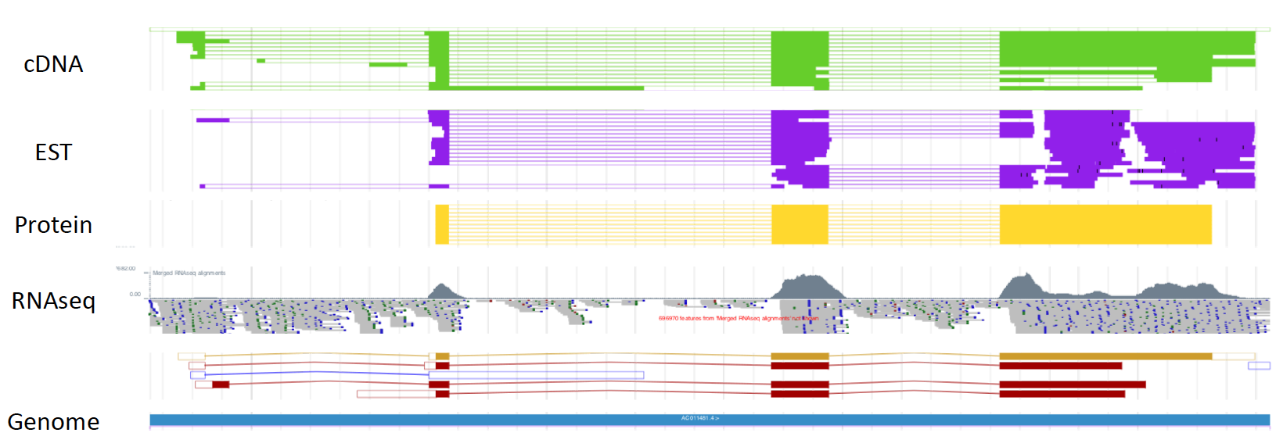
Gene Annotation
…
Annotation based on transcriptional evidence (mRNA, EST, Protein, RNA-Seq).
Automatic Annotation | Manual Annotation
Fast | Slow
Suitable for unfinished or shotgun sequences | Ideal for finished sequence
Consistent – rule based | Flexible – allows for biological exceptions
Under or over prediction | Expert analysis, including publications

Slide 14
Genome Browsers
Notes:
Pg 66 of notes

Slide 15
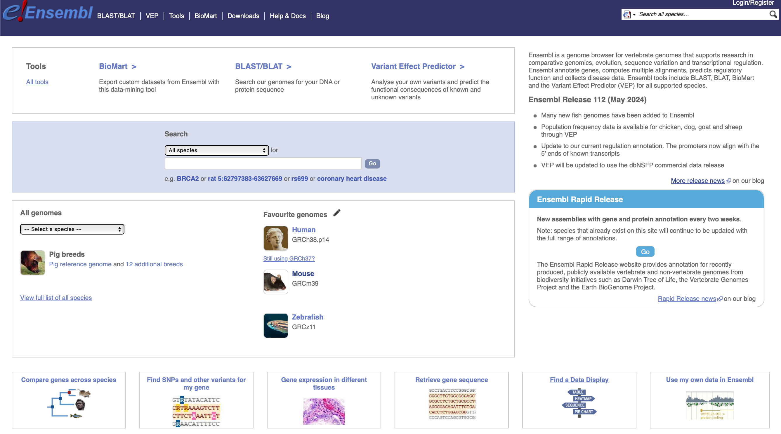
Genome Browsers
Ensembl example
Go to http://www.ensembl.org
and search for the Apoe gene.
Notes:
provides tools for viewing and analyzing genomic data
• includes annotation of regulatory, transcriptional and variant data
-Annotations can be added or removed and appear as tracks aligned to DNA sequence.
Let’s have a quick look at how to use these browsers work.

Slide 16
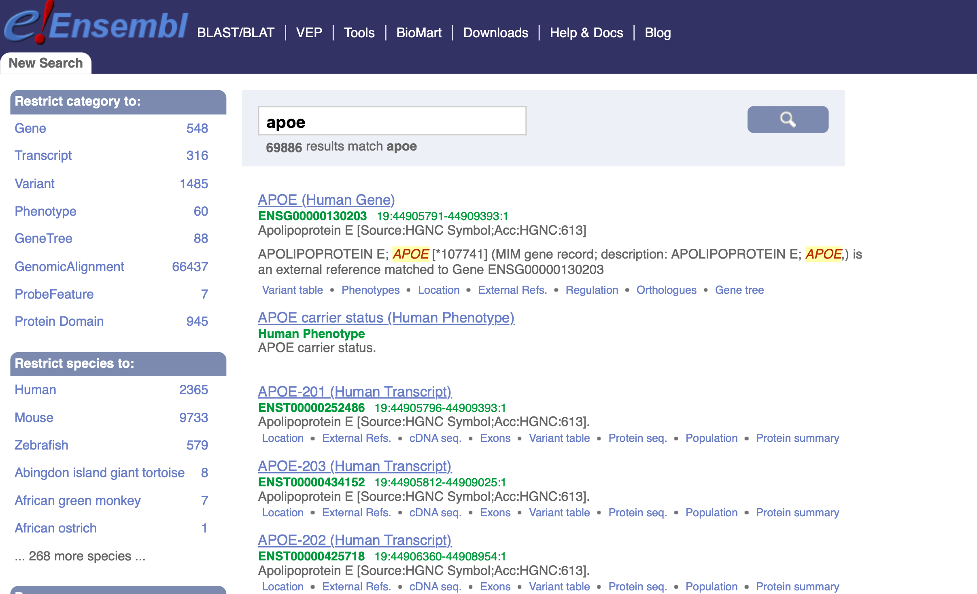
Genome Browsers
Ensembl example
The results table lists ”Apoe” found in all species, including entries for gene and transcripts.
Notes:
Filter the data to view mouse genes.

Slide 17
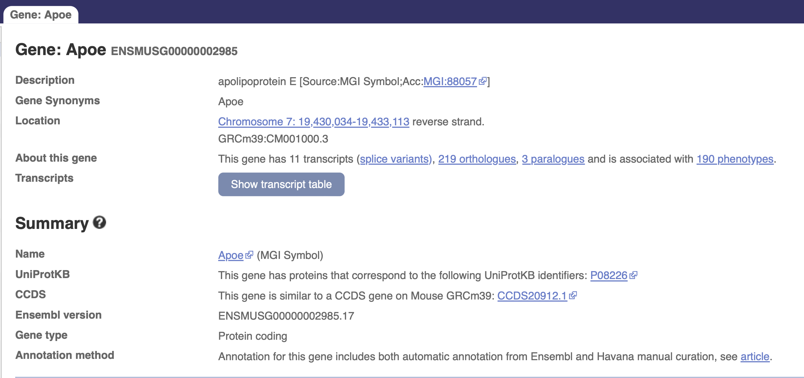
Genome Browsers
Ensembl example
Click on the Apoe gene entry to open the ‘Gene Tab’
Click on “Show transcript table”
Notes:
At the top of the page, a summary of the gene information is shown at the top of the page, including related identifiers in other databases

Slide 18
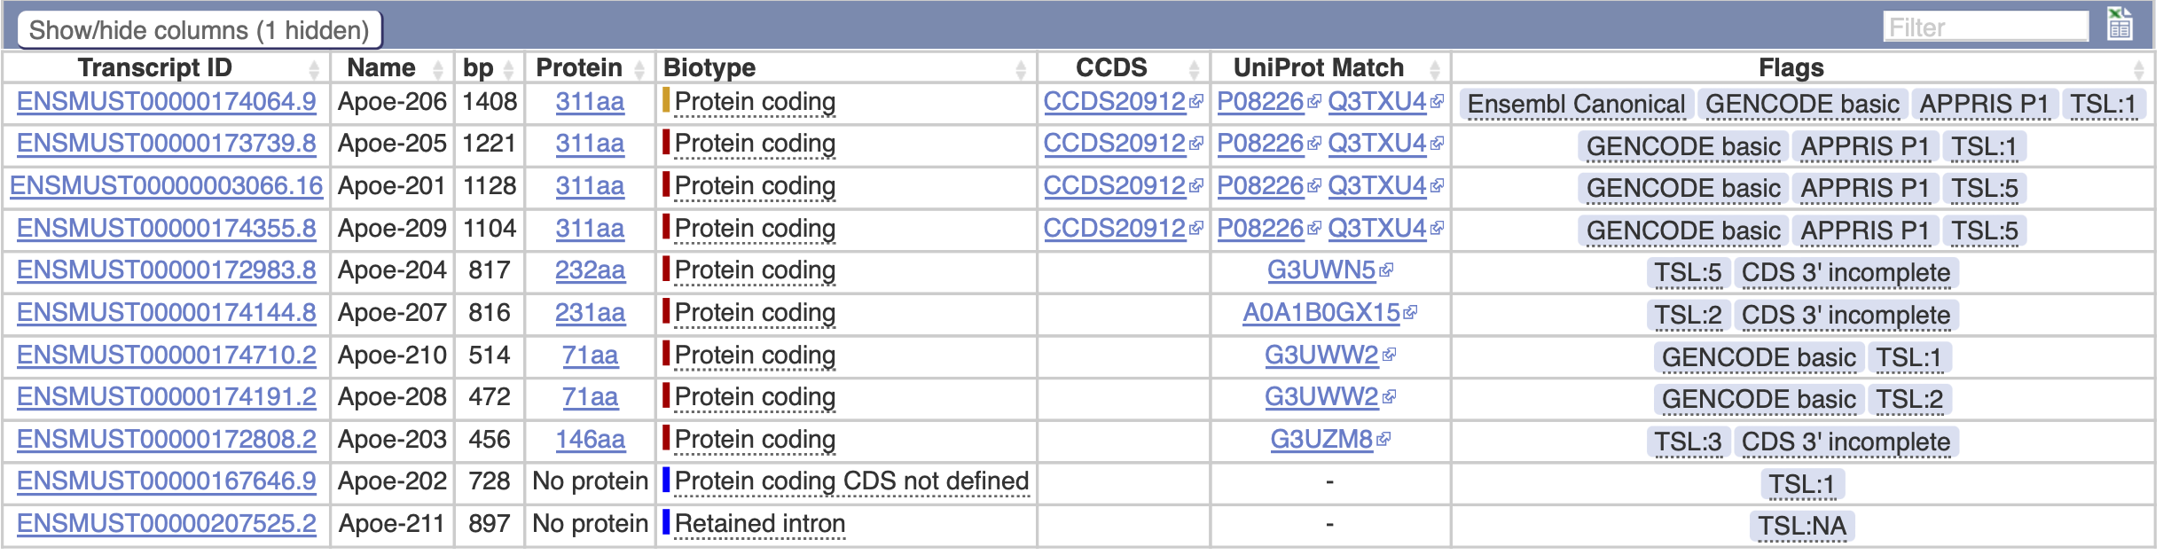
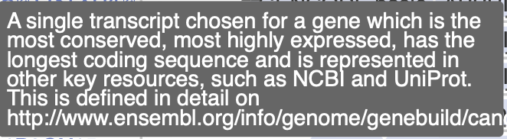
Genome Browsers
Ensembl example
This allows you to view details such as identifiers, biotypes and transcript “Flags”.
Position the cursor over a flag to view more information.
Close the transcript table and view the graphical display of all transcripts within the genomic context.

Slide 19
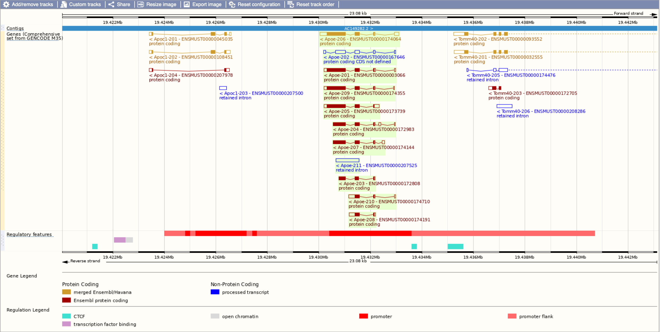
Genome Browsers
Ensembl example
Transcripts are displayed in different colours to indicate their origin.

Slide 20
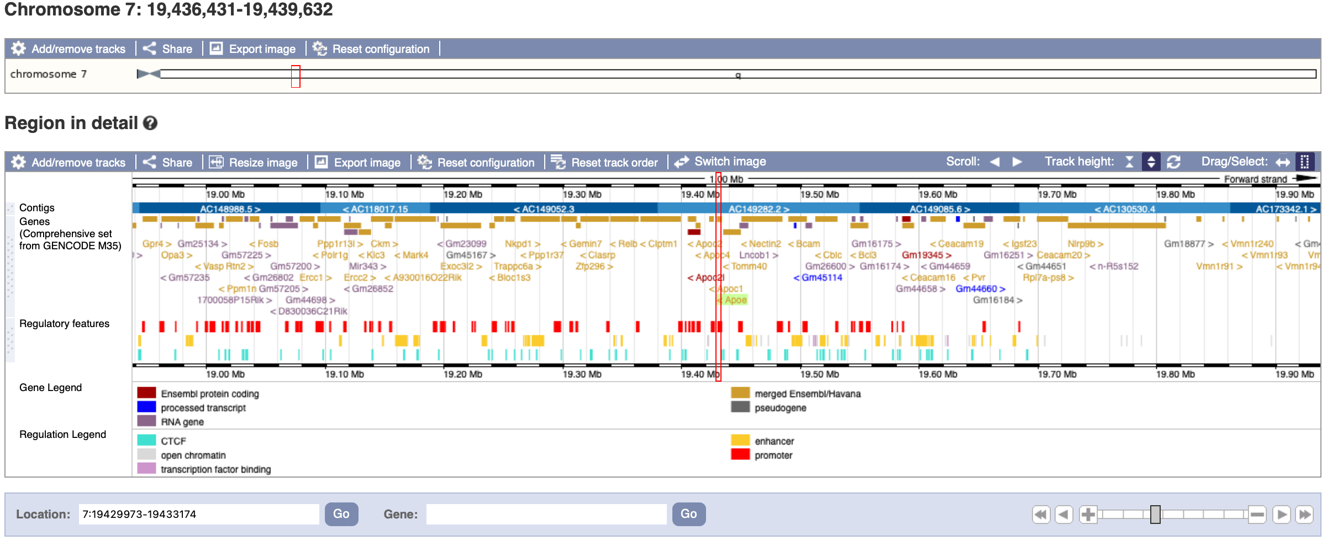
Genome Browsers
Ensembl example
Click on ‘Region in detail’.
Ensembl displays the GENCODE comprehensive gene set by default (shown below), which includes all annotated transcripts.
Notes:
Just above the graphical display, select ”Region in detail”. This interactive view allows you to scroll, zoom.
In circumstances that we will discuss later; the basic gene set is required. We need to add this track manually.

Slide 21
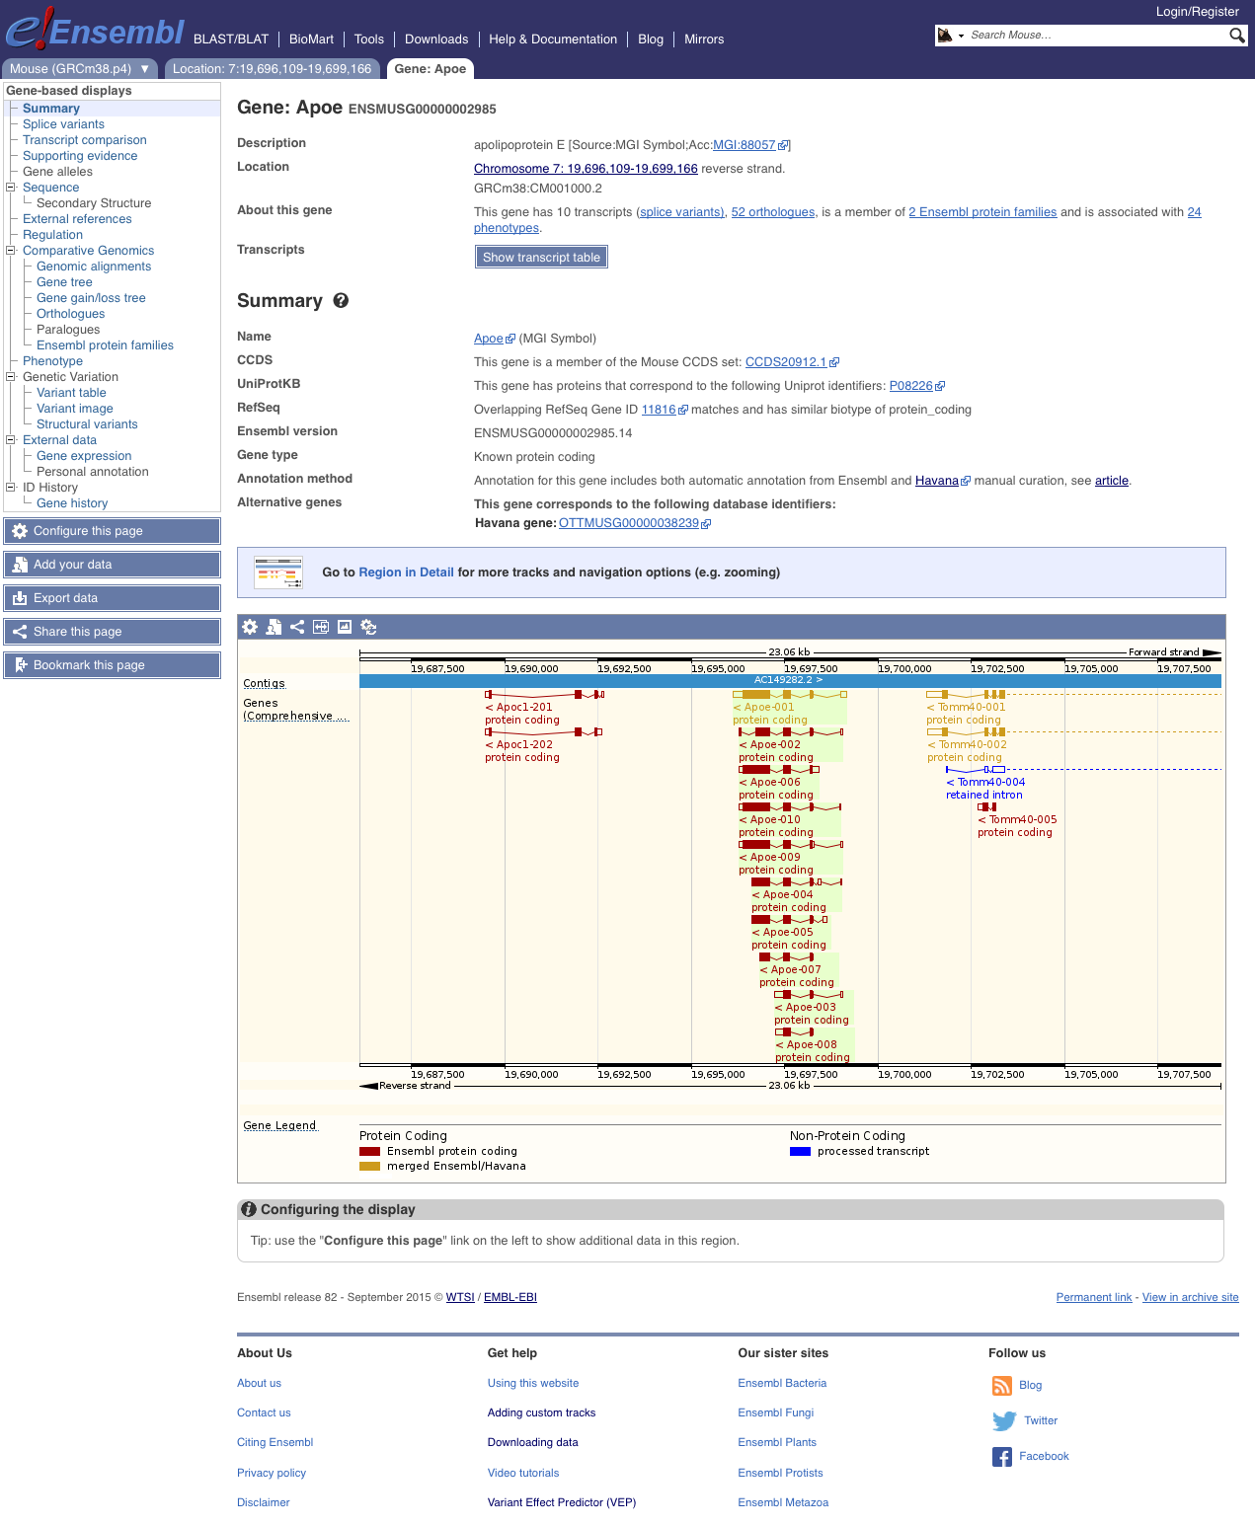
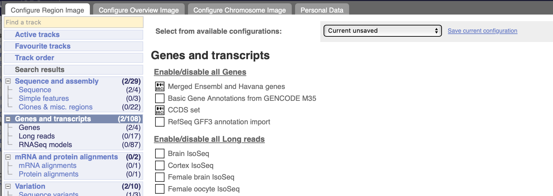
Genome Browsers
Ensembl example
To display the GENCODE Basic gene set, first select “Configure this page” from the side menu.
A new tab opens, and you can select desired options from the menu.
The Basic gene set only shows the main isoforms.

Slide 22
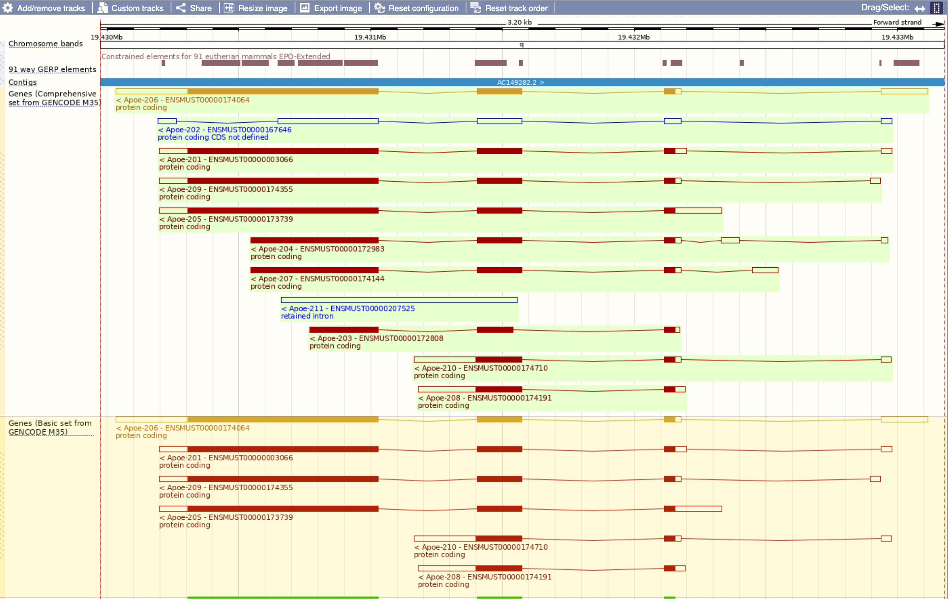
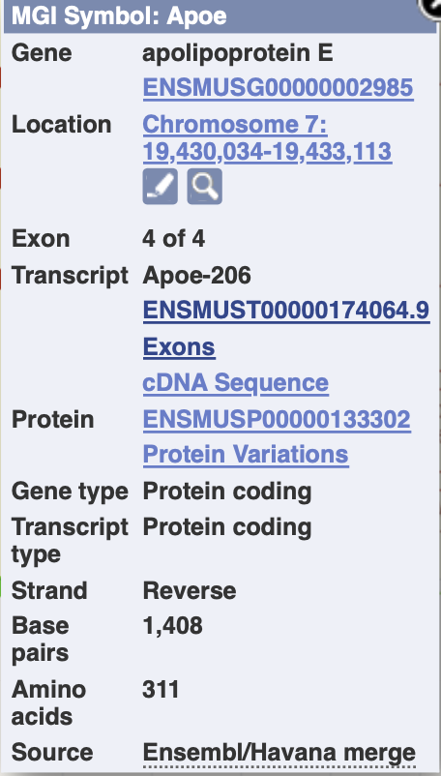
Genome Browsers
Ensembl example
View information about the transcript, exons and protein.
Notes:
Click on a transcript, then transcript ID number to open a page with detailed information about that transcript.

Slide 23
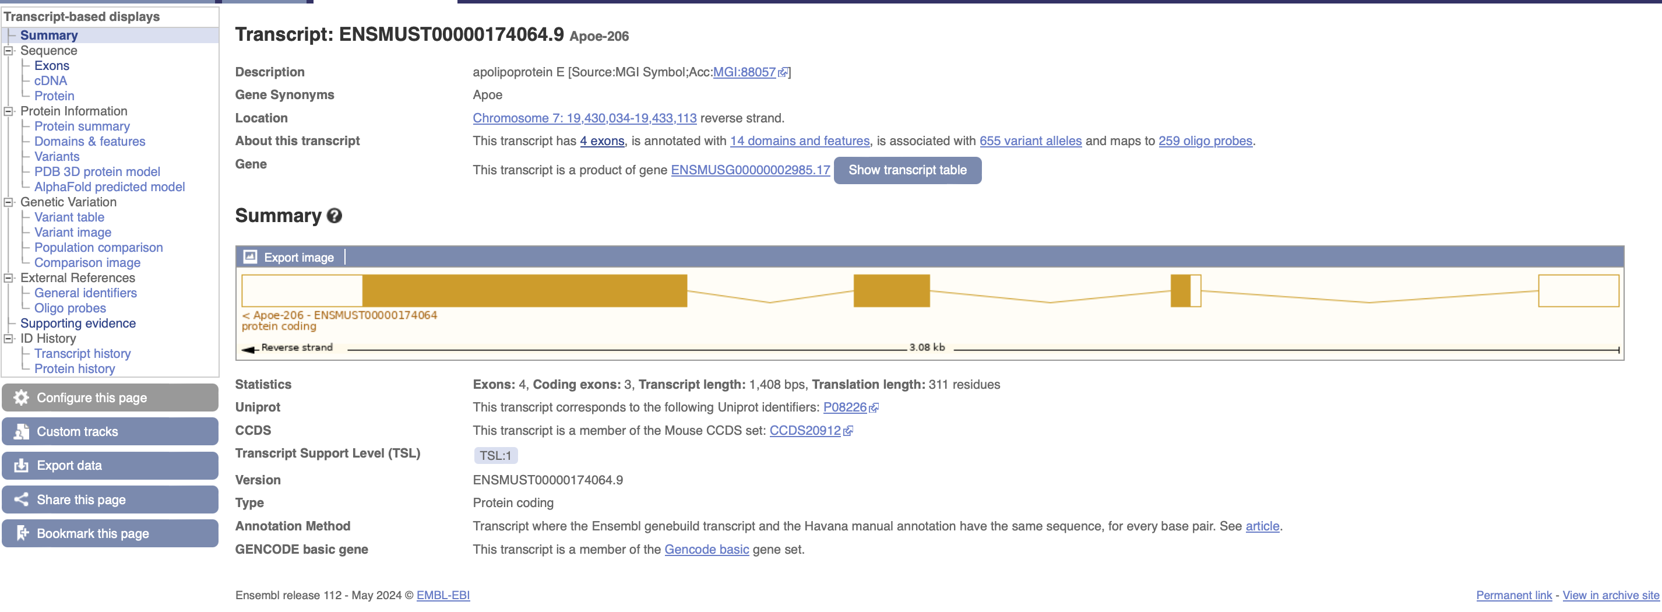
Genome Browsers
Ensembl example
From this view, use the side menu to view data such as supporting evidence, exon information and protein domain.

Slide 24
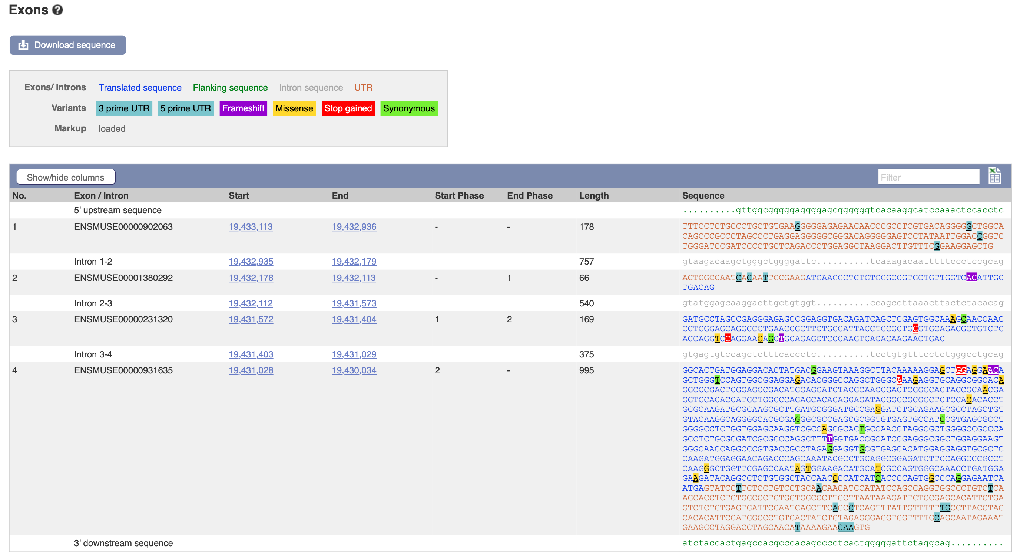
Genome Browsers
Ensembl example
Exon summary displays UTRs, CDS and common variants that are colour coded.
Exon start and end phases (reading frames) are listed.

Slide 25
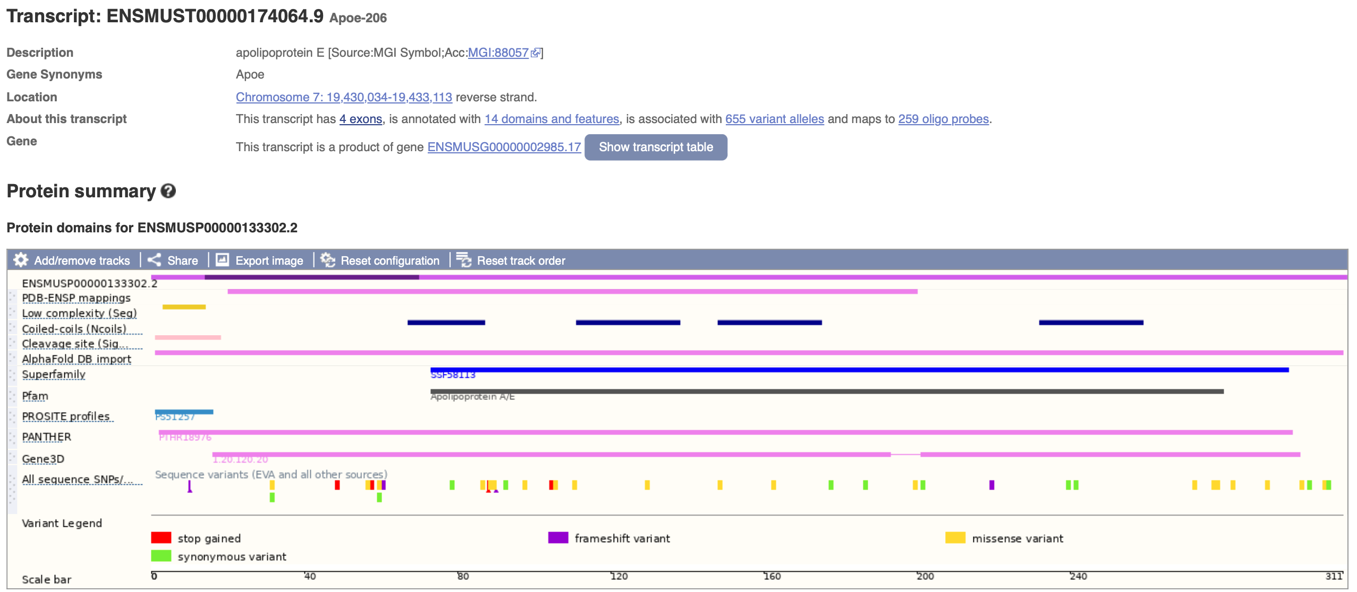
Genome Browsers
Ensembl example
Protein summary displays protein domains, signal peptides and transmembrane regions relative to the coding exons.

Slide 26
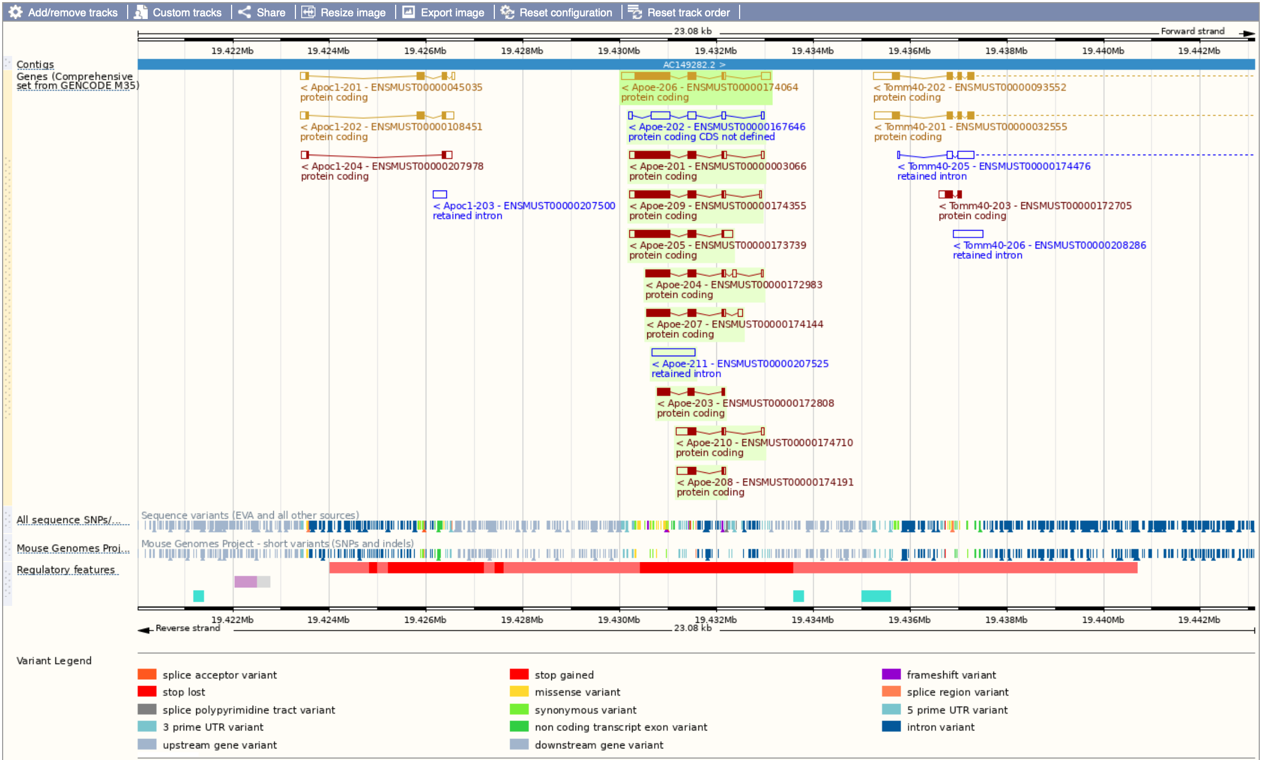
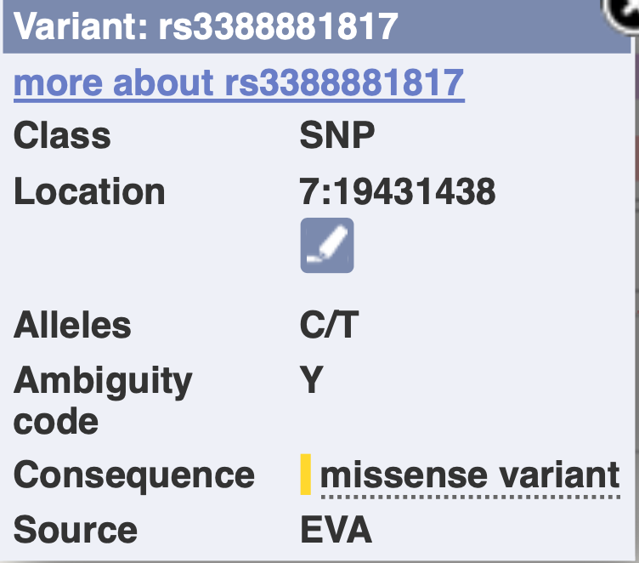
Genome Browsers
Ensembl example
Variation data in Ensembl is a colour coded annotation that denotes the consequence of the change, e.g. frameshift.

Slide 27
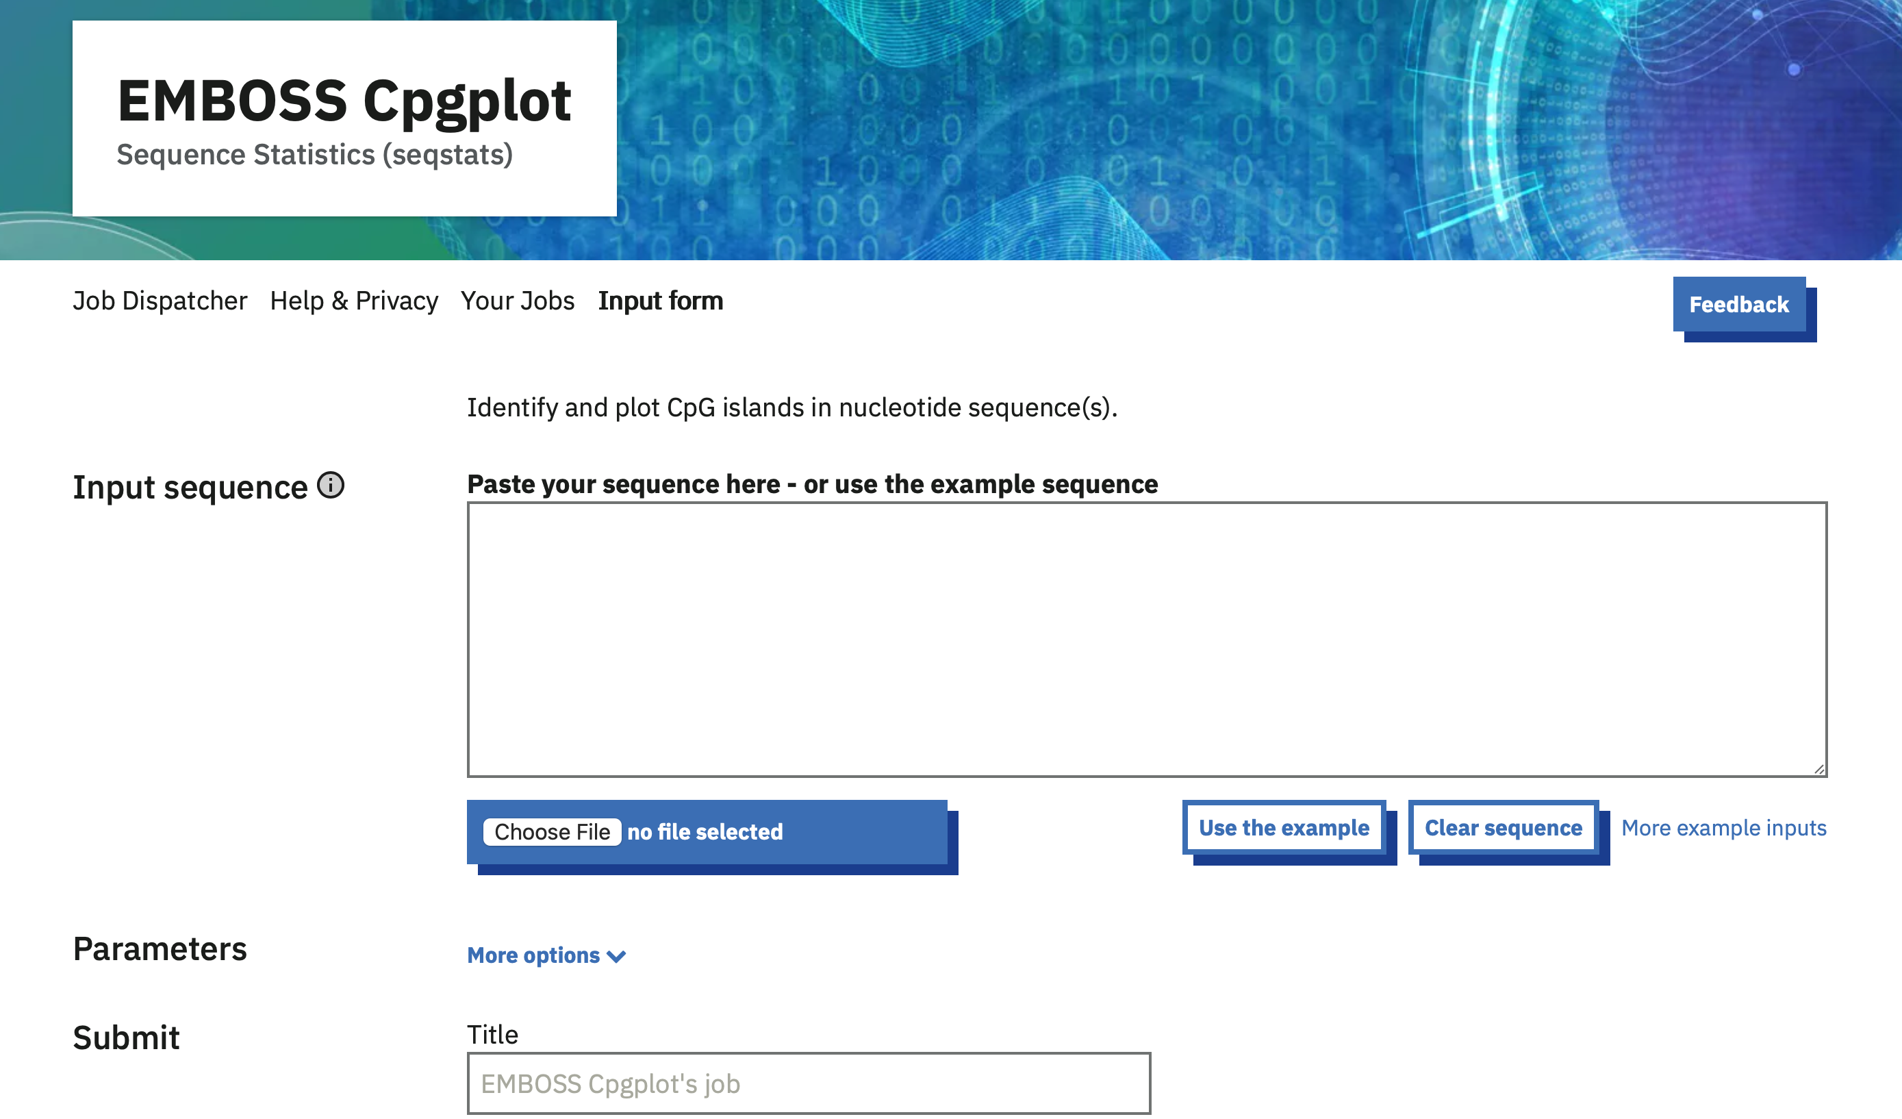
Genome Browsers
Ensembl example
Export data for use in other software (e.g. EMBOSS CpGPlot or CRISPR sgRNA design tool).
https://www.ebi.ac.uk/jdispatcher/seqstats/emboss_cpgplot

Slide 28
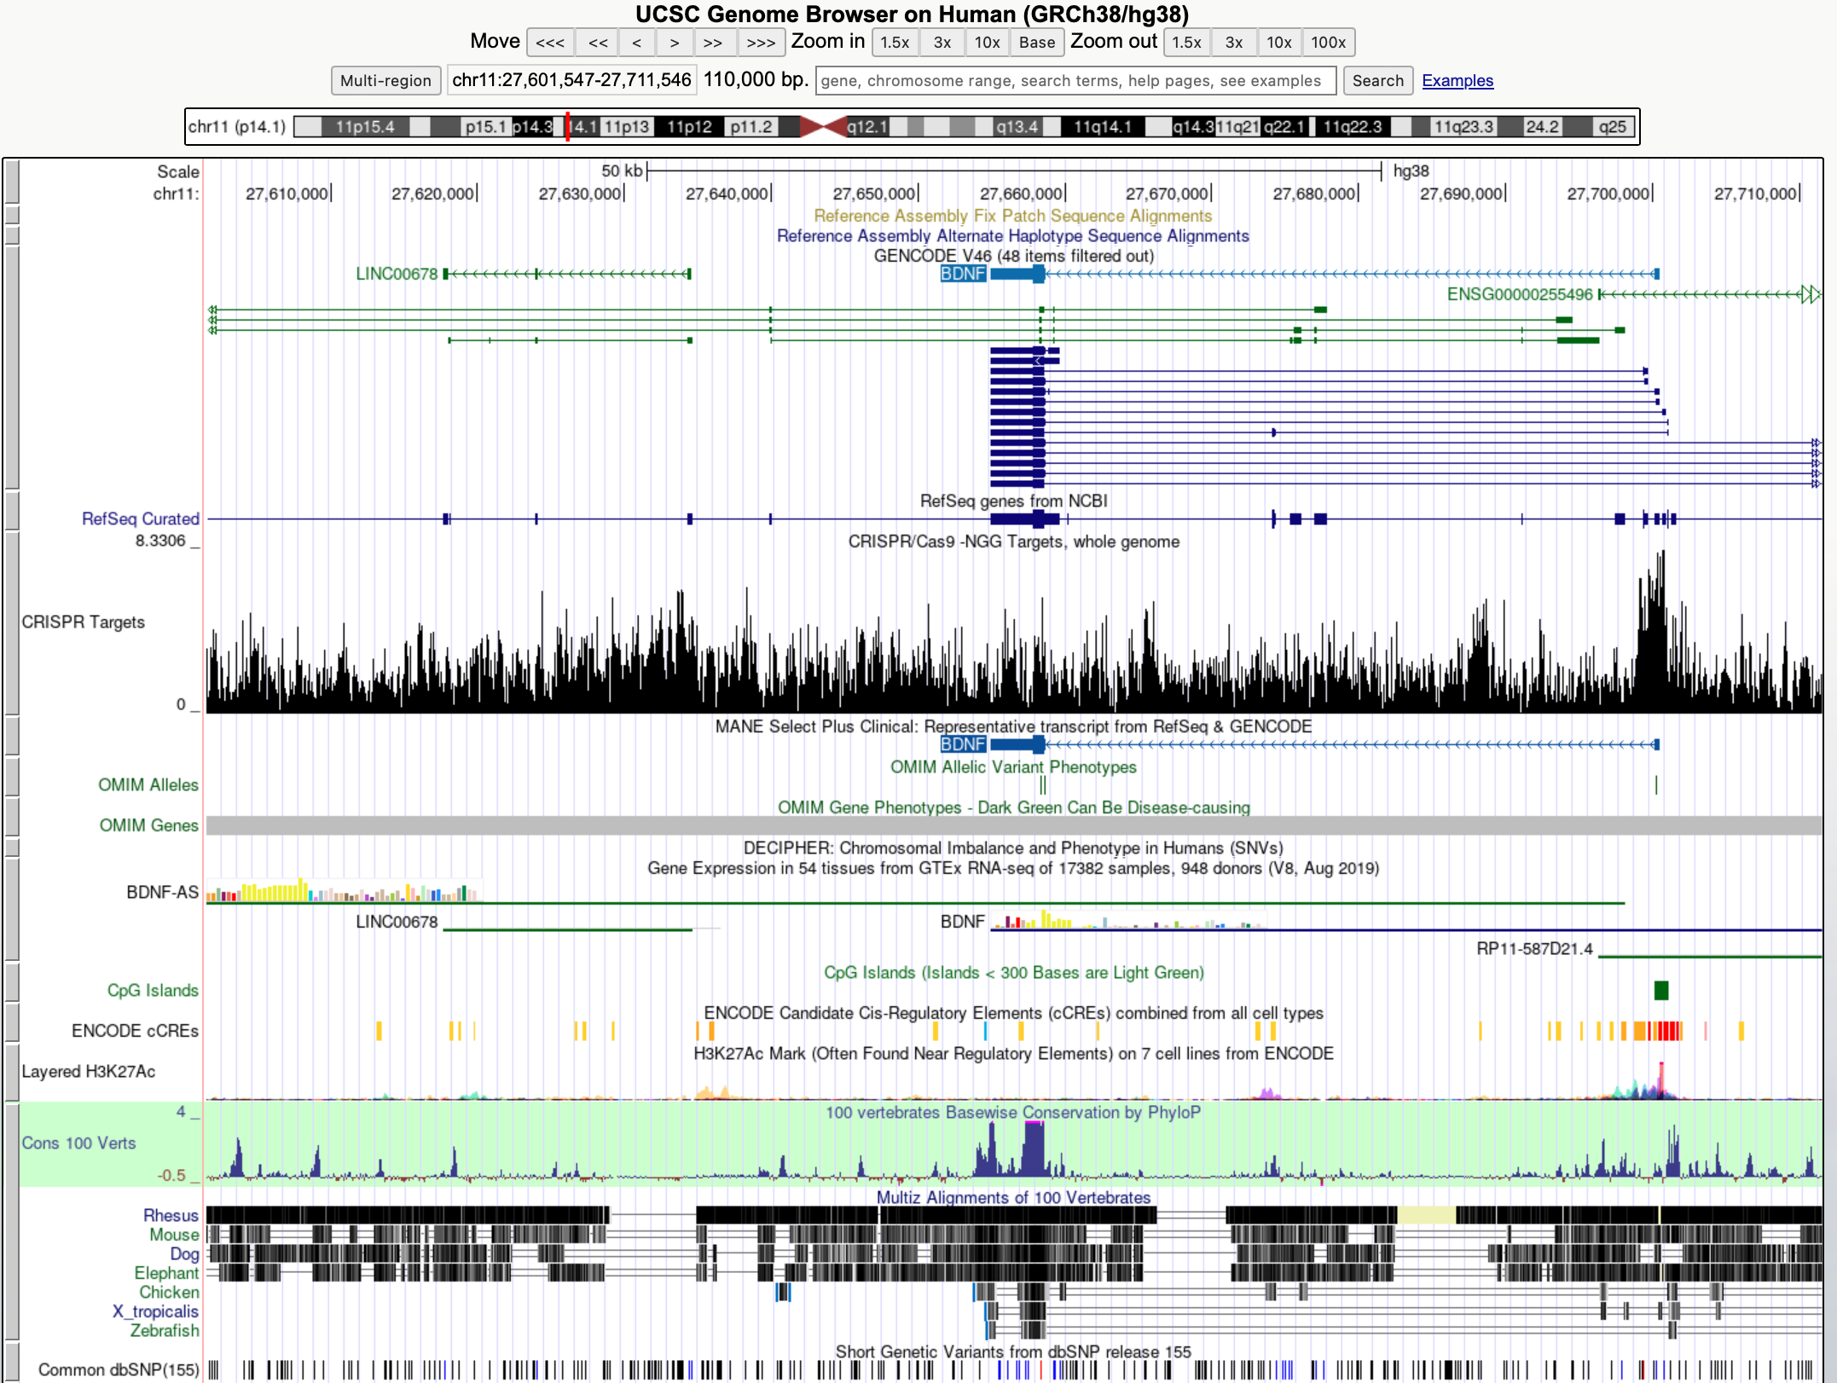
Genome Browsers
Other browsers
UCSC genome browser: http://genome.ucsc.edu

Slide 29
Gene Structure
Notes:
Pg 66 of notes

Slide 30
Gene Structure
What is a gene?
Protein coding or non-protein coding DNA sequences.
intronic splice enhancers/silencers
5’ UTR
3’ UTR
CpG island
splice donor
splice acceptor
polyA
upstream repressor
ATG
intron
5’
3’
upstream activator
TFBS
TSS
exon
exonic splice enhancers/silencers
transription
translation
promoter
TATA
OH
PMT
Notes:
Gene expression in regulated by other DNA features such as promoters, enhancers. And by molecular modifications such as methylation of CpG islands and splicing.
Let’s look at some of these features in turn.

Slide 31
Gene Structure
Enhancers and Repressors
Analysis of chromatin interactions reveals details of regulatory domains and promoter interactions.
e1
e2
enhancer
promoter/gene
CTCF
H3K4me3
1D locations are really 3D interactions
e1
e2
Notes:
Enhancers and repressors are often transcription factors, or part of a larger protein complex. They bind to DNA regulatory regions and modulate gene expression. Transcription factor binding sites are annotated in genome browsers (Regulatory features track).

Slide 32
Gene Structure
CpG islands and DNA methylation
CpG islands (un-methylated) are distinct from other CpG dinucleotides (methylated).
Often found near promoter regions ethylation of CpG island typically inactivates gene expression.
NH₂
NH₂
H
CH₃
5-Adenosyl-L-methionine
5-Adenosyl-L-homocysteine
O
Cytosine
DNA Methyltransferase
O
Methylcytosine
Methylated CpG site
Unmethylated CpG site
CpG finder algorithm is optimized for human, which can penalize other species.
Experimental methylation data is more accurate.
Notes:
CpG islands are regions of nucleic acid sequence containing a high number of adjacent cytosine guanine pairs (along one strand).
DNA methylation and results in condensation to form a heterochromatin structure.
MECP-1 and -2(Methyl cytosine binding protein) which binds directly to the CpG sites to cause repression of the gene expression

Slide 33
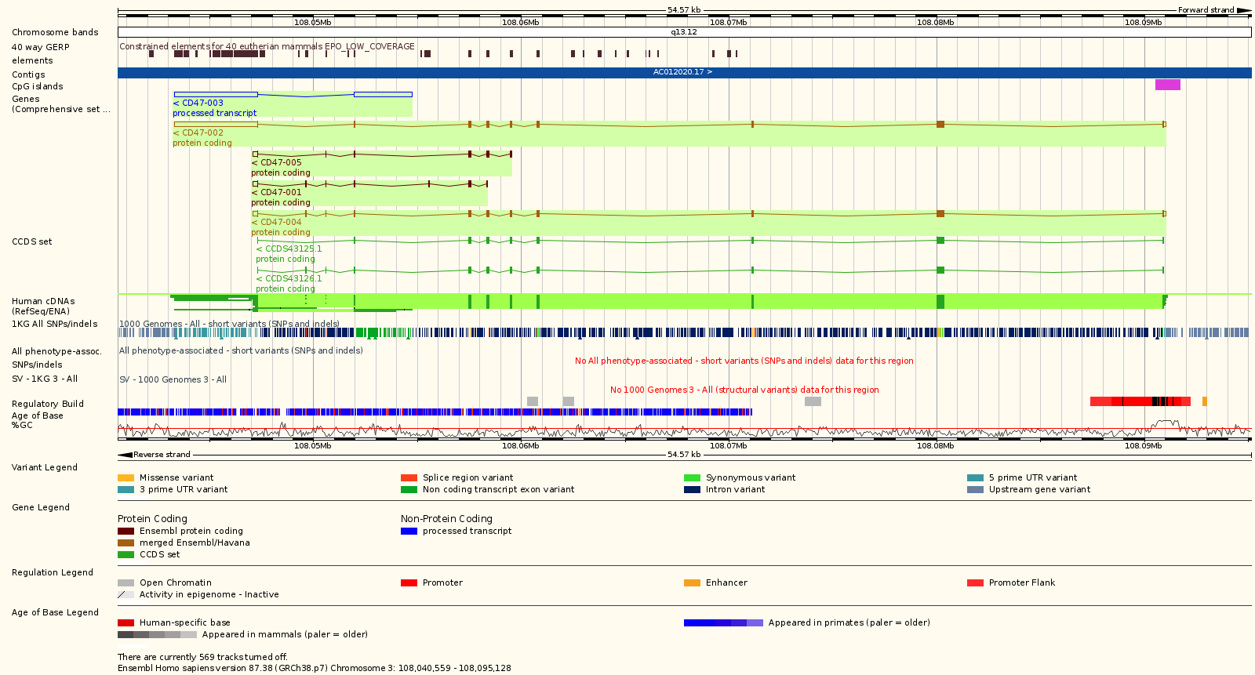
Gene Structure
Untranslated regions (UTR)
Different 5’ UTR isoforms associated with
Promoters (e.g. tissue specificity)
Transcription start sites (TS)
Translation start sites
Differences in 3’ UTR associated with
Alternative polyadenylation (ApA)
mRNA stability, localisation, expression and regulation
Human CD47 molecule
Notes:
CD47 3’ UTR length determines cellular location
- Short isoform localised to ER
- Long isoform localised to cell surface

Slide 34
Gene Structure
Transcription Start Site
GENCODE TSS positions coincide with the first nucleotide position of transcripts
• often based on extent of evidence, rather than experimental validation.
Large scale experimental data provided by the ENCODE and Fantom5
consortiums
• ENCODE contains Cap Analysis of Gene Expression (CAGE) and RAMPAGE data
• Fantom5 provides CAGE-seq peaks identifying TSS in different tissues and cell
types for human and mouse
• Ongoing efforts to improve TSS annotation, with associated experimental
data.
Notes:
A short region of DNA found immediately upstream of the transcription start site of a gene that contains binding sites for RNA polymerase to induce gene expression.
Cap Analysis of Gene Expression (CAGE) , a sequencing technique to map active transcription, transcription factors and enhancers.

Slide 35
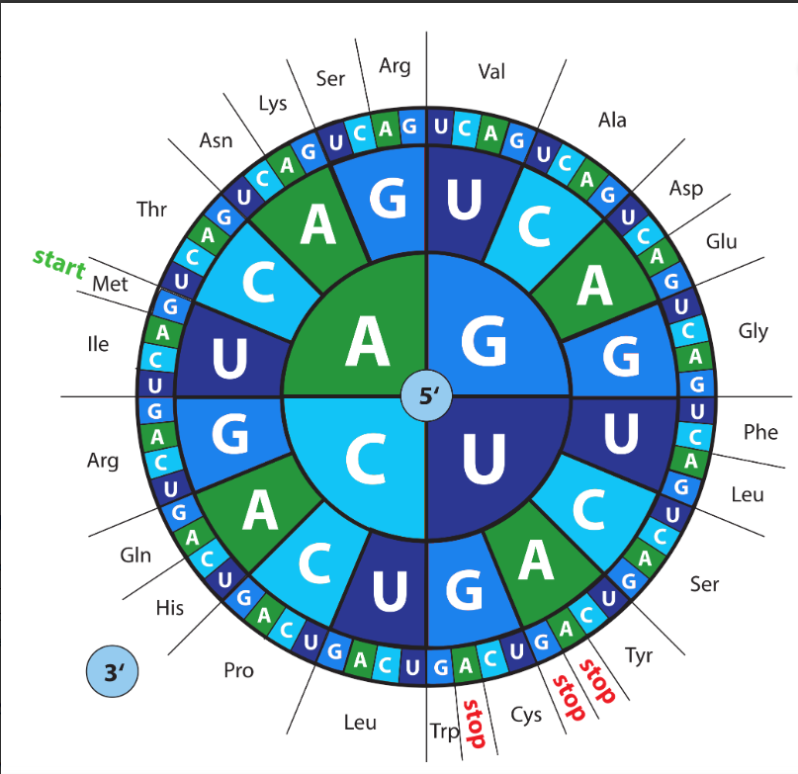
Gene Structure
CDS and Exon
Coding sequence (CDS) defines translated regions.
Different transcripts can have a different CDS for the same gene.
Every three bases of a CDS defines a codon for a specific tRNA.
Provides 3-frames of translation for forward or reverse strand.
Image taken from Eurofins

Slide 36
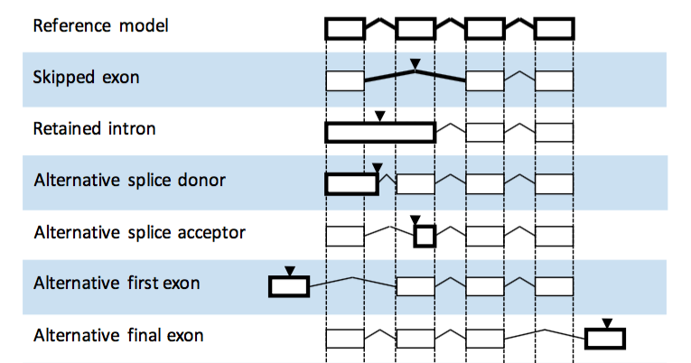
Gene Structure
Alternative splicing
Most genes are subject to alternative splicing, which can include alternative first or last exons, exon skipping or variation in splice acceptor/donor sites.
Different protein isoforms
Alternative promoters and transcription start sites (TSS) can also give rise to isoforms.
If alternative splicing introduces a premature stop codon, the aberrant transcript is degraded by the
Nonsense-mediated decay (NMD) pathway.

Slide 37
Gene Structure
Translation re-initiation
Occurs when a ribosome encounters a termination codon soon after the initiation codon, allowing the ribosome to progress through short ORFs found in the 5’ UTR.
Translation re-initiation is likely when a STOP codon <35 aa away from initiating methionine. It is also determined by the rate at which the translation initiation complex dissociates.
Notes:
This has implications for gene knockouts, as introducing a premature termination codon too soon, may result in translation re-initiation; potentially producing an N-terminally truncated protein.

Slide 38
Gene Structure
Long non-coding RNA (lncRNA)
protein
lncRNA
AAAAA
lncRNA
mRNA
lncRNA interactome
small weight compounds
miRNA
lncRNA
lncRNA
lncRNA
DNA
Notes:
lncRNAs directly bind DNA sequences and inhibit gene transcription; in addition, they directly interact with proteins (primarily transcription factors) and inhibit or activate the expression of downstream genes

Slide 39
CRISPR Design Process and Tools
Notes:
Pg 66 of notes

Slide 40
CRISPR Design Process and Tools
Are there any other genes or genomic elements in close proximity?
Are there alternative first or last exons?
Step 1: Gene structure and location
Are there alternative translation start sites?
Definition of the gene start and end?
Which transcript is most representative?
Notes:
The design process involves multiple stages, ensuring that all the necessary components are
considered before starting the experimental work.

Slide 41
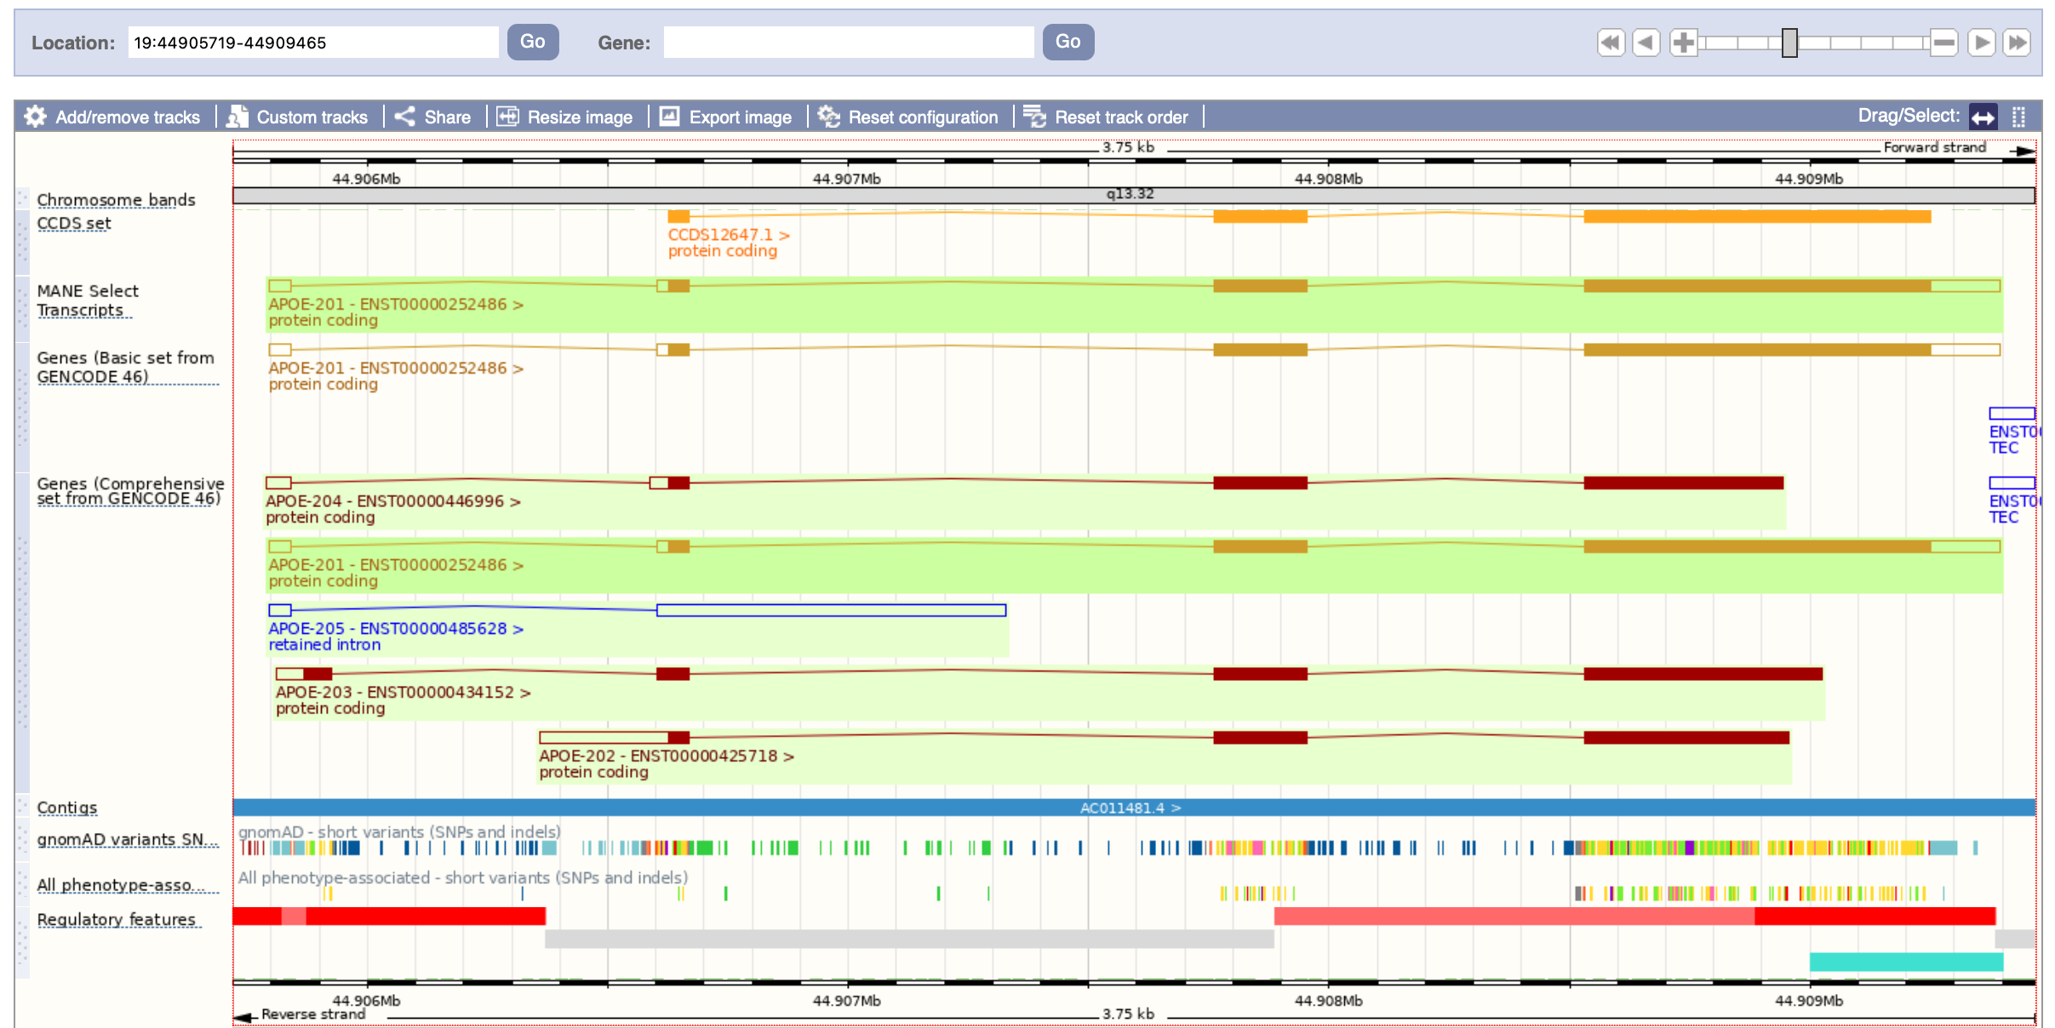
CRIPSR Design Process
Basic vs Comprehensive gene sets.
Notes:
The comprehensive gene set is required to answer the first set of questions regarding the loci.
Here we can see an isoform with an alternative TSS/ start exon.
There are also isoforms with 3’ truncated ends.
As well as non-coding protein transcript that neighbors the 3’ end of the gene of interest.
The most representative transcript is the one highlighted by the Basic gene set.

Slide 42
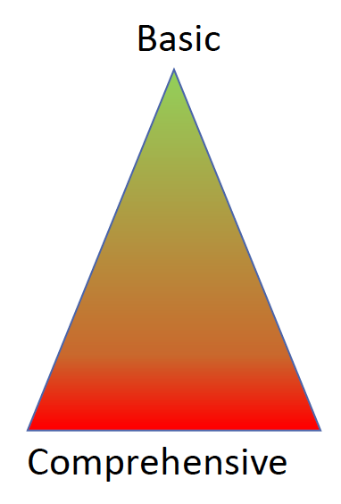
CRIPSR Design Process and Tools
Sequence data complexity
Large deletions
genes or loci
Point mutations
Knockouts
NHEJ disruption
Exon deletion
Activation/Repression
CRISPRa/i

Slide 43
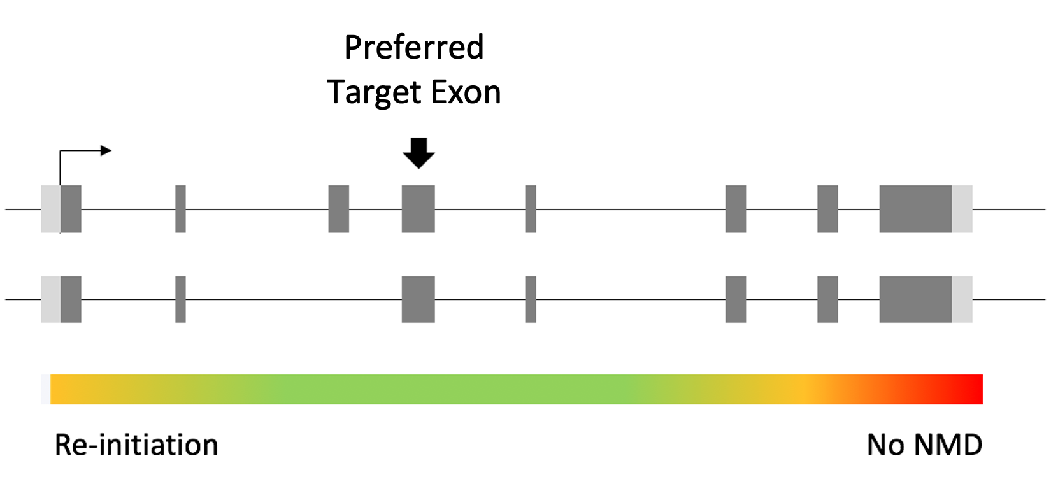
CRISPR Design Process and Tools
Which exons are common to all transcript isoforms?
Which exon(s) encode protein domains??
Step 2: Identify target region(s)
Will the mutant allele avoid translation re-initiation and be susceptible to
nonsense-mediated decay (NMD)?
Notes:
Avoid translation re-initiation and possible production of N-terminal truncated protein.

Slide 44
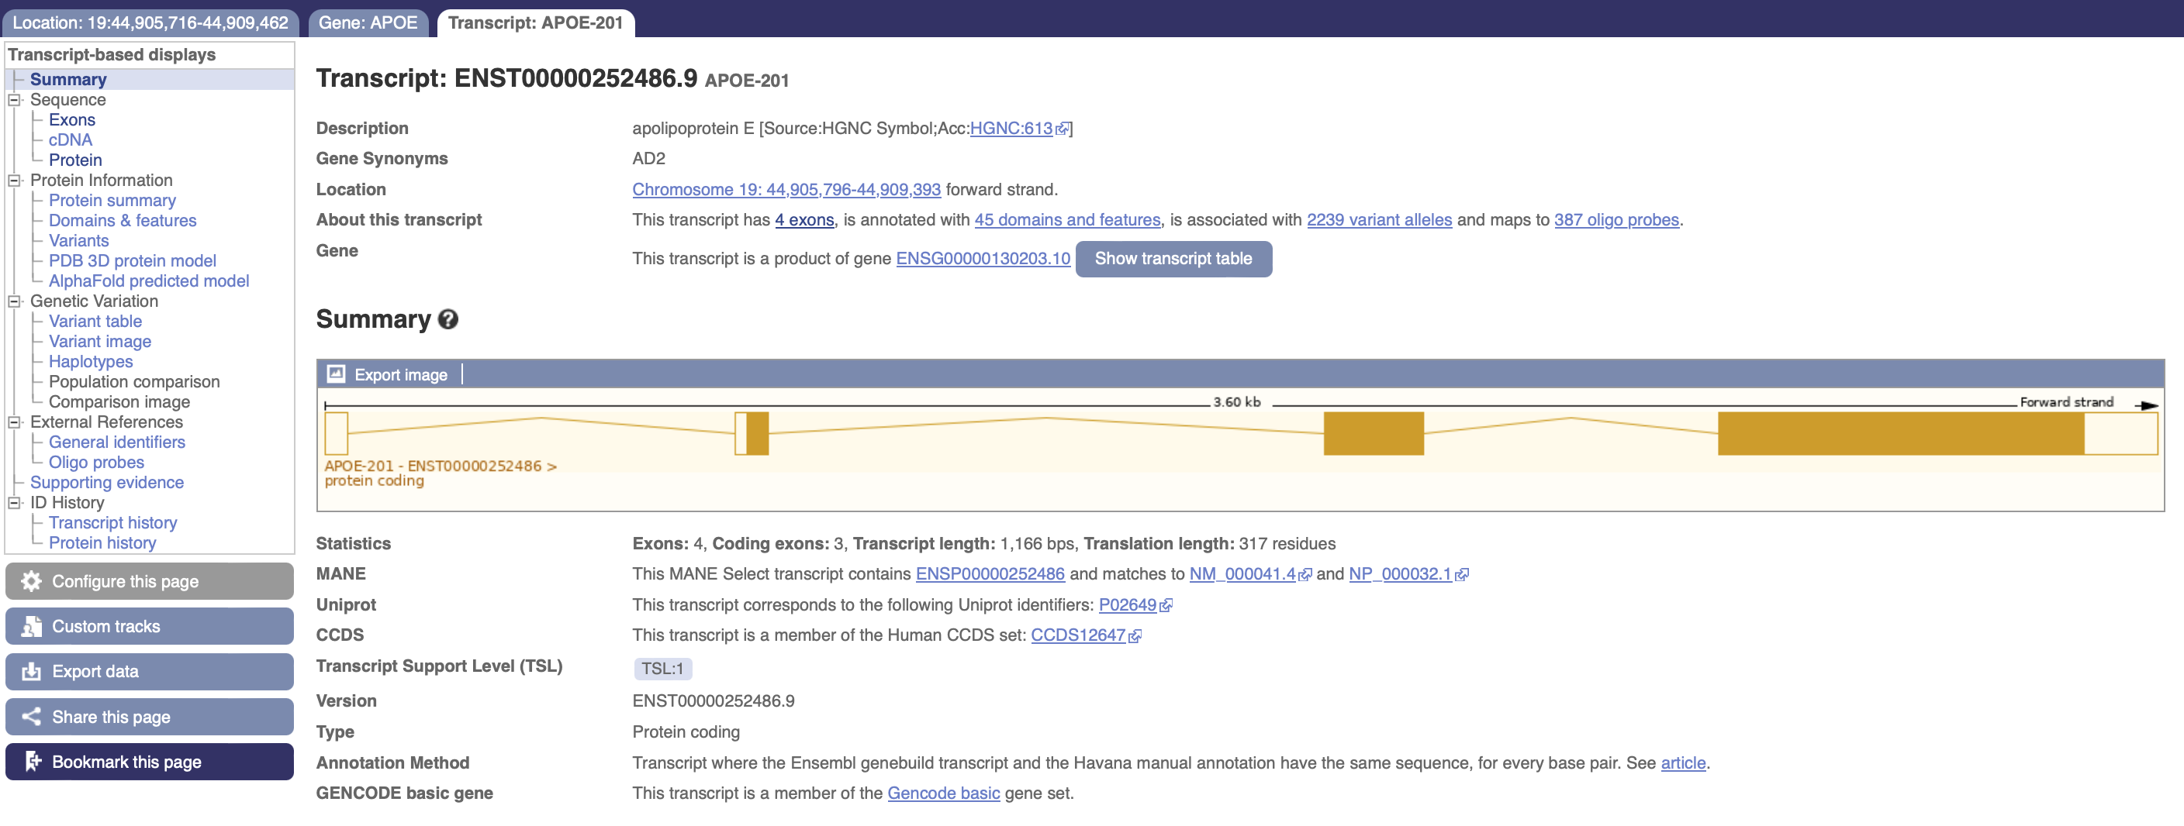
CRISPR Design Process and Tools
Open the transcript in a new window.
Notes:
Exon 3 is common to all transcripts.
To find out which exons contain domain we need to take a closer look at the transcript of interest.
In the side menu select “Protein summary”

Slide 45
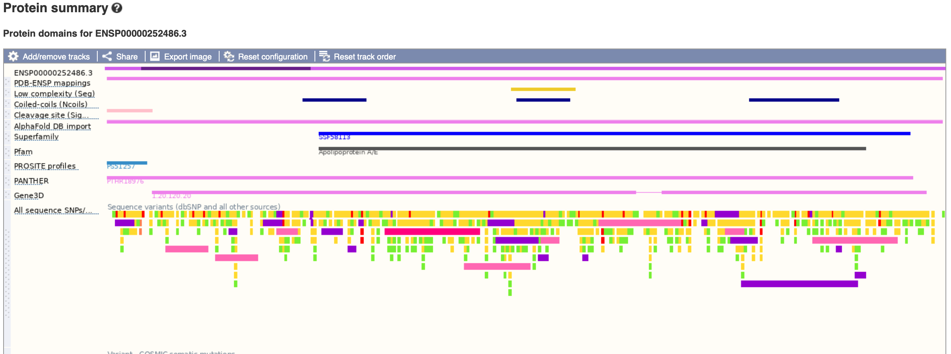
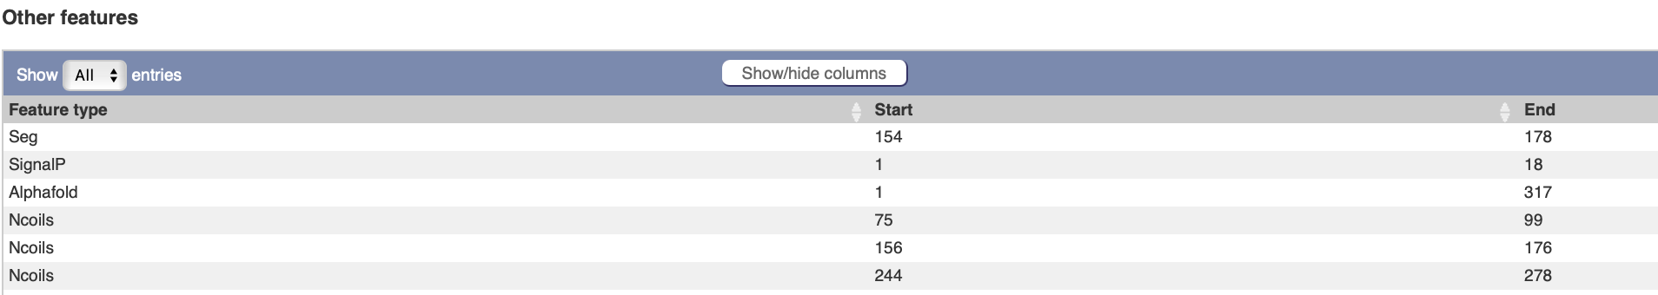
CRISPR Design Process and Tools
Notes:
Here we can see there are three coiled-coil domains.
You can also see the precise amino acids the contribute to each domain by selecting the “domain and features option from the side menu.

Slide 46
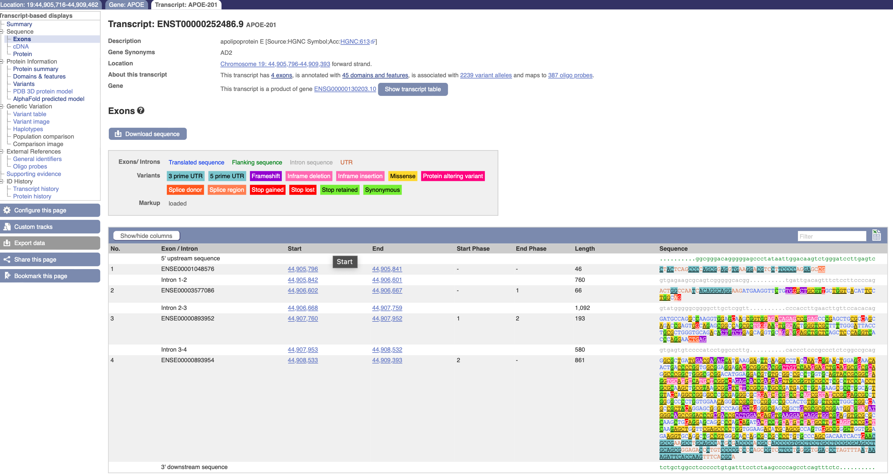
CRISPR Design Process and Tools
The first coiled-coil (aa 75-99) is in exon 3.
Notes:
We need to go back to the Exon tab and calculate which exons contain coiled-coil domains.
Within exon 3 we can also find a position greater than 35 amino acids from the initiating Met, to avoid translation re-initiation.
And potential also, greater than 50 bp upstream of a splice site. Such that a premature stop codon can induce nonsense-mediated decay.

Slide 47
Stage II – Identify target region(s)
• Identify constitutive exons, common to all transcript isoforms.
• Which exon(s) encode protein domains?
• Will the mutant allele avoid translation re-initiation and be susceptible to
nonsense-mediated decay (NMD)?
Translation Re-initiation
Translation re-initiation is a normal cellular process that allows translating ribosomes to ‘scan’
over short-ORFs within the 5’ UTR, so that they can reach the canonical ATG for the main CDS.
It can occur when a ribosome encounters a termination codon, a short distance (≤35 aa) downstream
of an initiating ATG, allowing translation to be re-initiated at the next available ATG. Assuming that a
frameshift mutation was introduced close to the normal ATG and translation were to re-initiate at an
in-frame methionine (ATG), then an N-terminally truncated protein may be produced.
Nonsense-Mediated Decay
This is a cellular process that prevents aberrant transcripts from being translated, which is induced
when a premature termination codon is encountered more than 50bp from the final splice donor site.
This process can be exploited when introducing a frameshift mutation for knockouts, resulting in the
degradation of mutant transcripts, with a corresponding loss of the knockout protein. This can be an
advantage when providing experimental proof for the loss of the knockout protein.

Slide 48
CRISPR Design Process and Tools
Low off-target scores and high on-target scores.
Avoid sgRNA with less than two mismatches.
Step 3: Select suitable gRNAs
Select sgRNA >50bp from the splice sites, to avoid disruption of splice junctions.
If there are no suitable gRNAs, go back to step 2 and identify a new target region.
Notes:
It is preferable to maintain the normal splicing arrangement for knockout transcripts, so that
the effects of a frameshift mutation can be predicted. Disruption of splice junctions can lead to
cryptic splicing or exon-skipping, which may be difficult to predict without transcriptomic analysis.
Correct splicing is also required for nonsense-mediated decay.

Slide 49
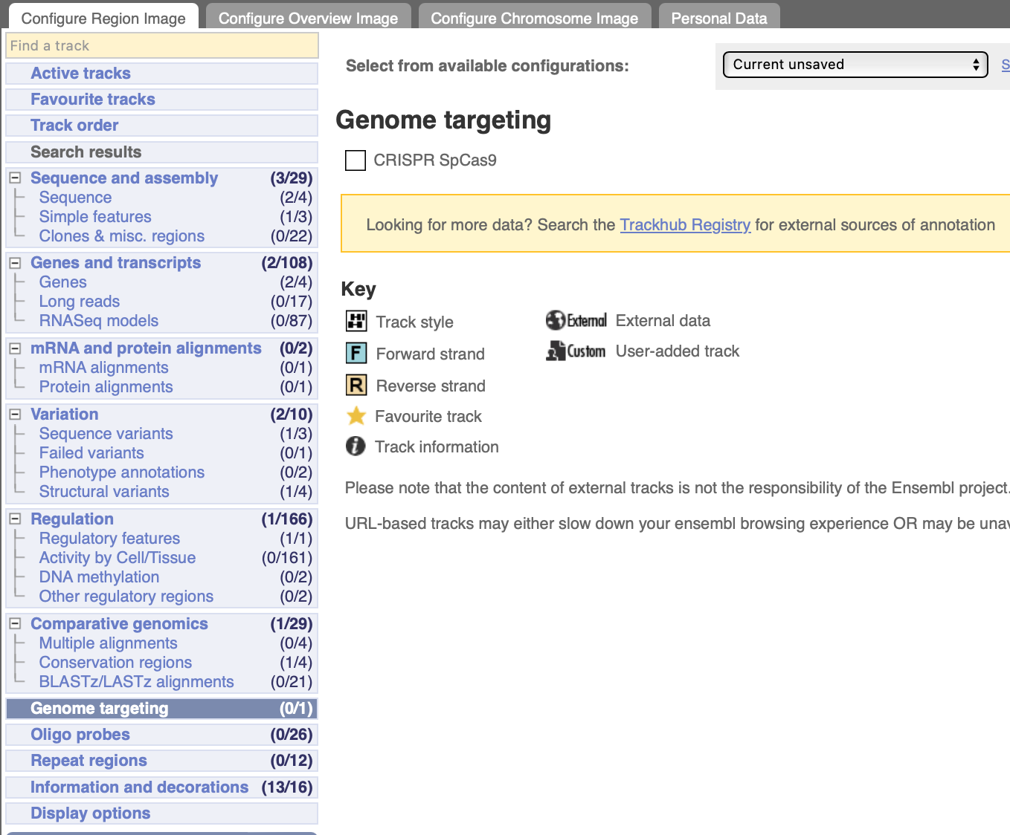
CRISPR Design Process and Tools
Go back to the location tab and add a track to the “region in detail”.
Notes:
NGG CRISPR sites identified by the Wellcome Trust Sanger Institute Genome Editing (WGE). https://doi.org/10.1093/bioinformatics/btv308

Slide 50
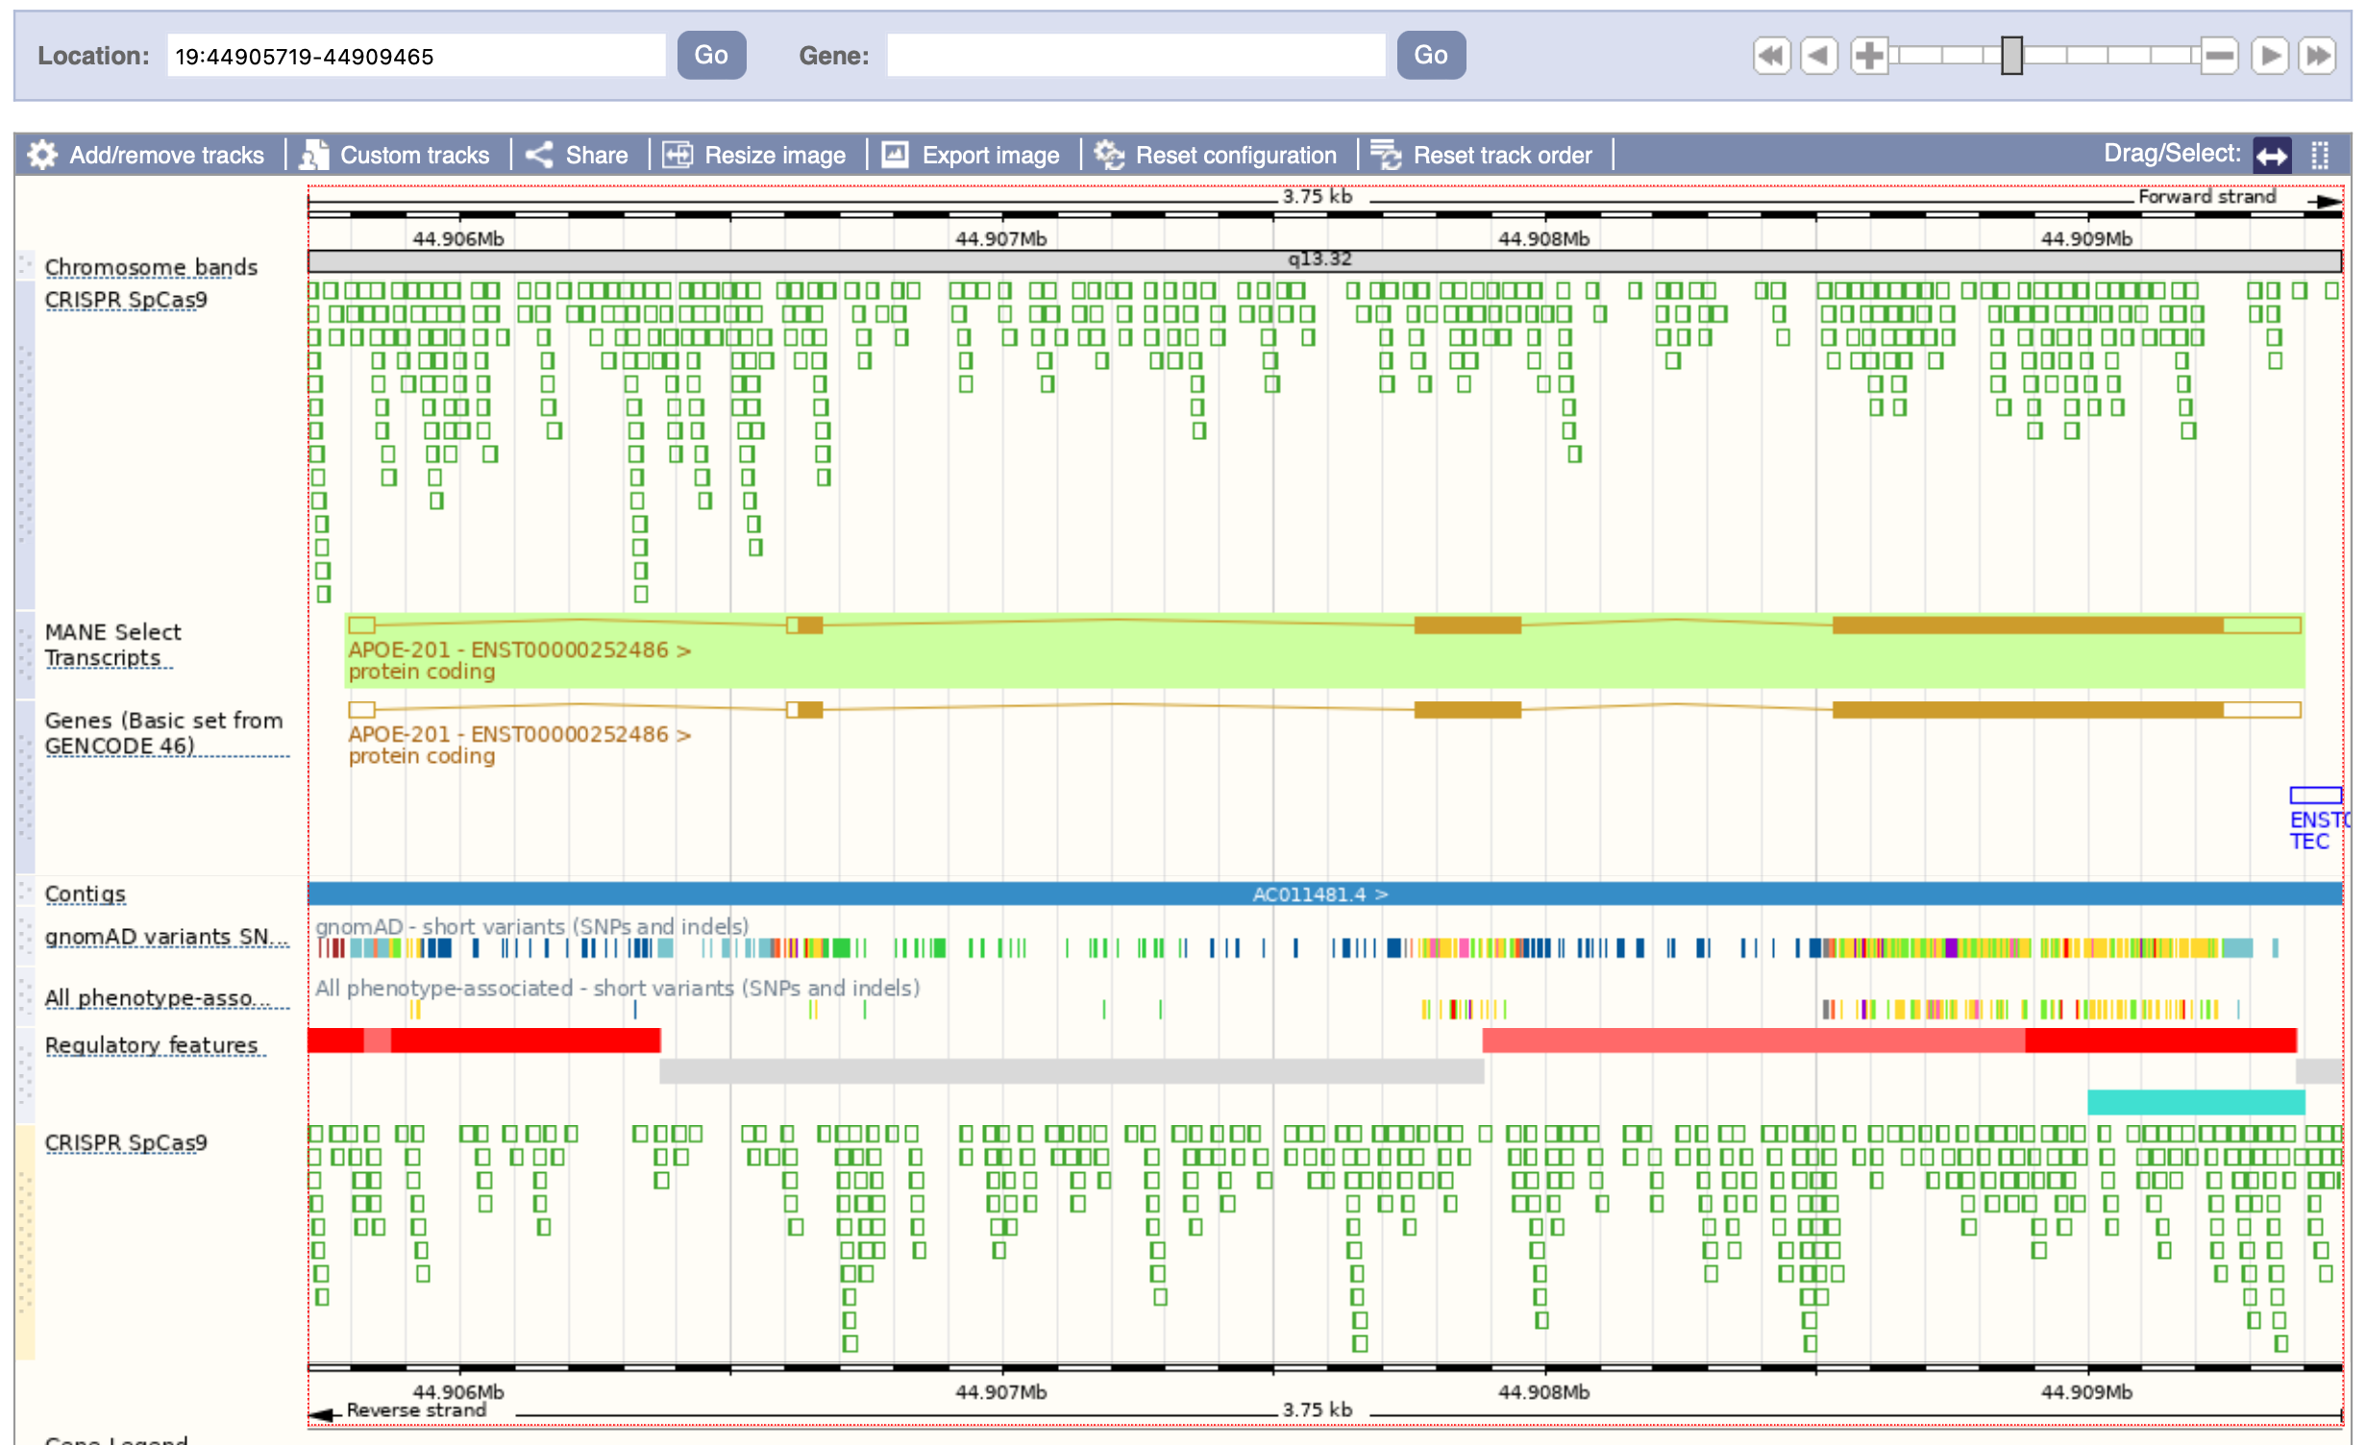
CRISPR Design Process and Tools
Guides targeting the forward strand are displayed on the top, and those targeting the reverse strand as shown below.
Notes:
NGG CRISPR sites identified by the Wellcome Trust Sanger Institute Genome Editing (WGE). https://doi.org/10.1093/bioinformatics/btv308

Slide 51
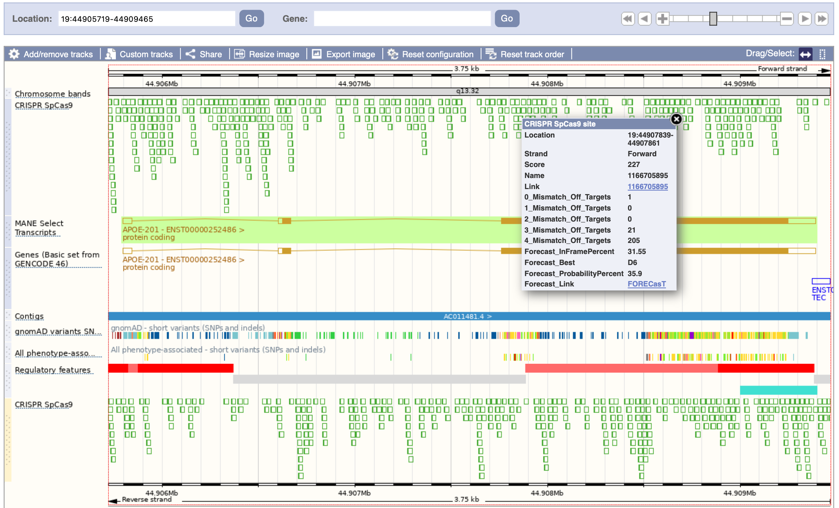
CRISPR Design Process and Tools
Information and links to other sources are available for each guide.
Notes:
The calculation of mismatches indicates that this guide might be a good choice. Here we can see only 1 location with zero mismatches, which corresponds to the location we wish to target with sgRNA. There are no locations with 1 or two mismatches, which satisfies our basic criteria for level of mismatches.
This data was generated by the Wellcome Sanger Institute Genome Editing (WGE) algorithm. The link takes to directly to a page with information about the specific guide.

Slide 52
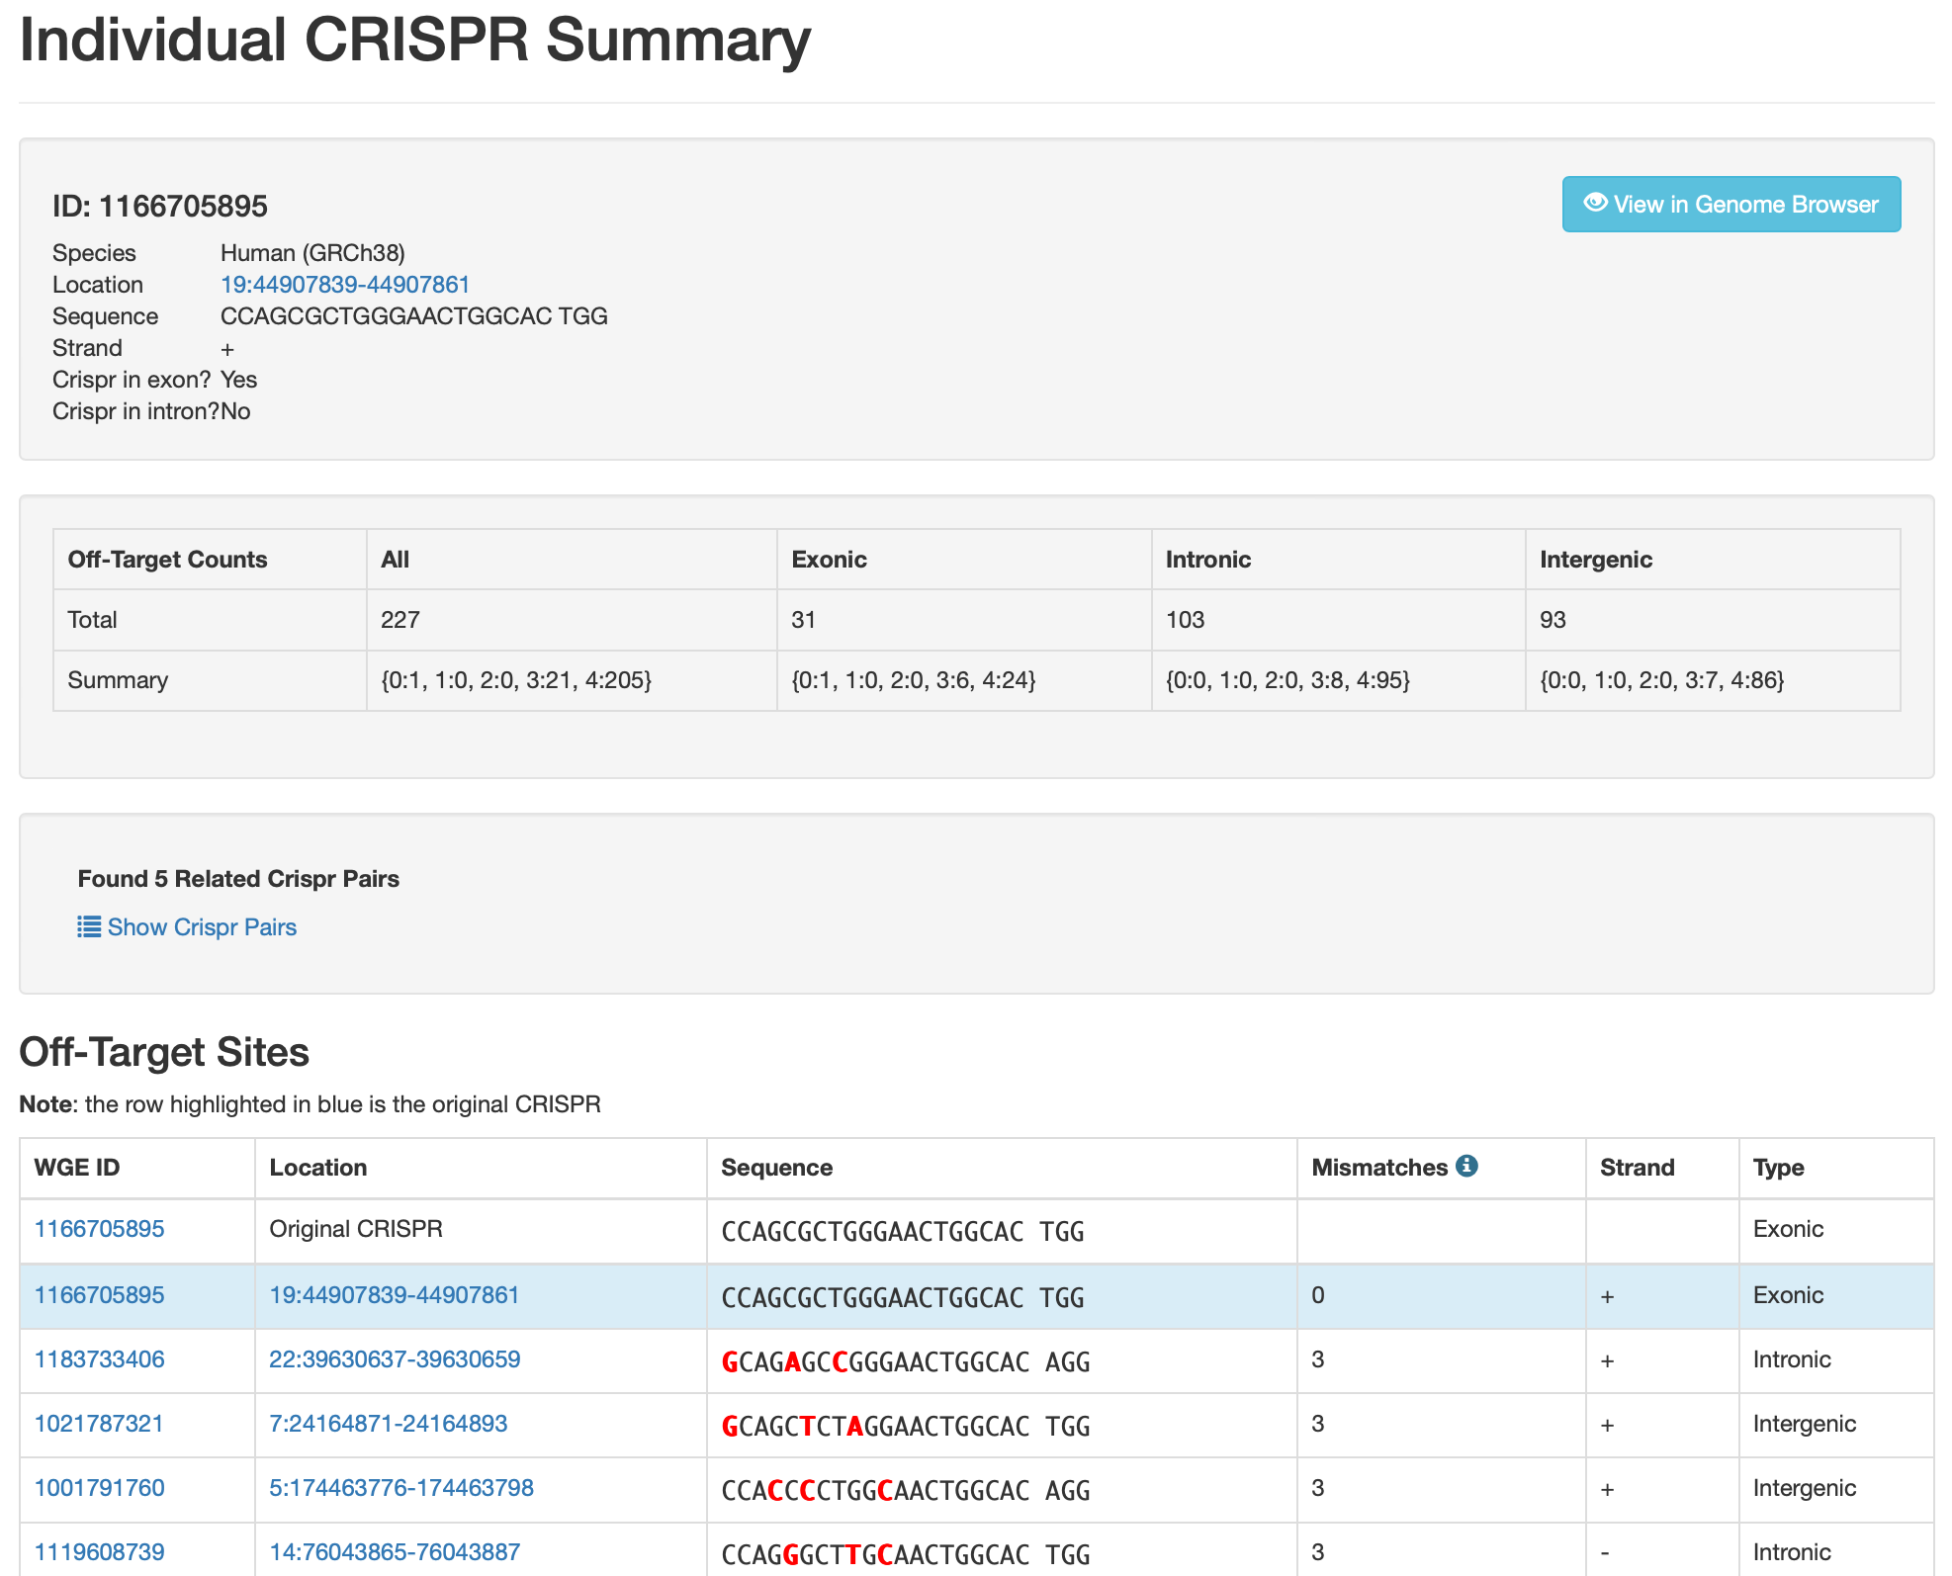
CRISPR Design Process and Tools

Slide 53
CRISPR Design Process and Tools
Information and links to other sources are available for each guide.
Nat Biotechnol 37, 64–72 (2019)
Notes:
This links to the homepage rather than the individual guide, so you would have to enter the genomic location and find the guide again. However, you might choose not to do this as the summary gives a good indication of your results.
Here you can see D6- which indicates that the most likely outcome is a deletion of 6 nucleotides. The probability of this occurring is 35.9%. The percentage of in-frame edits (multiples of three).

Slide 54
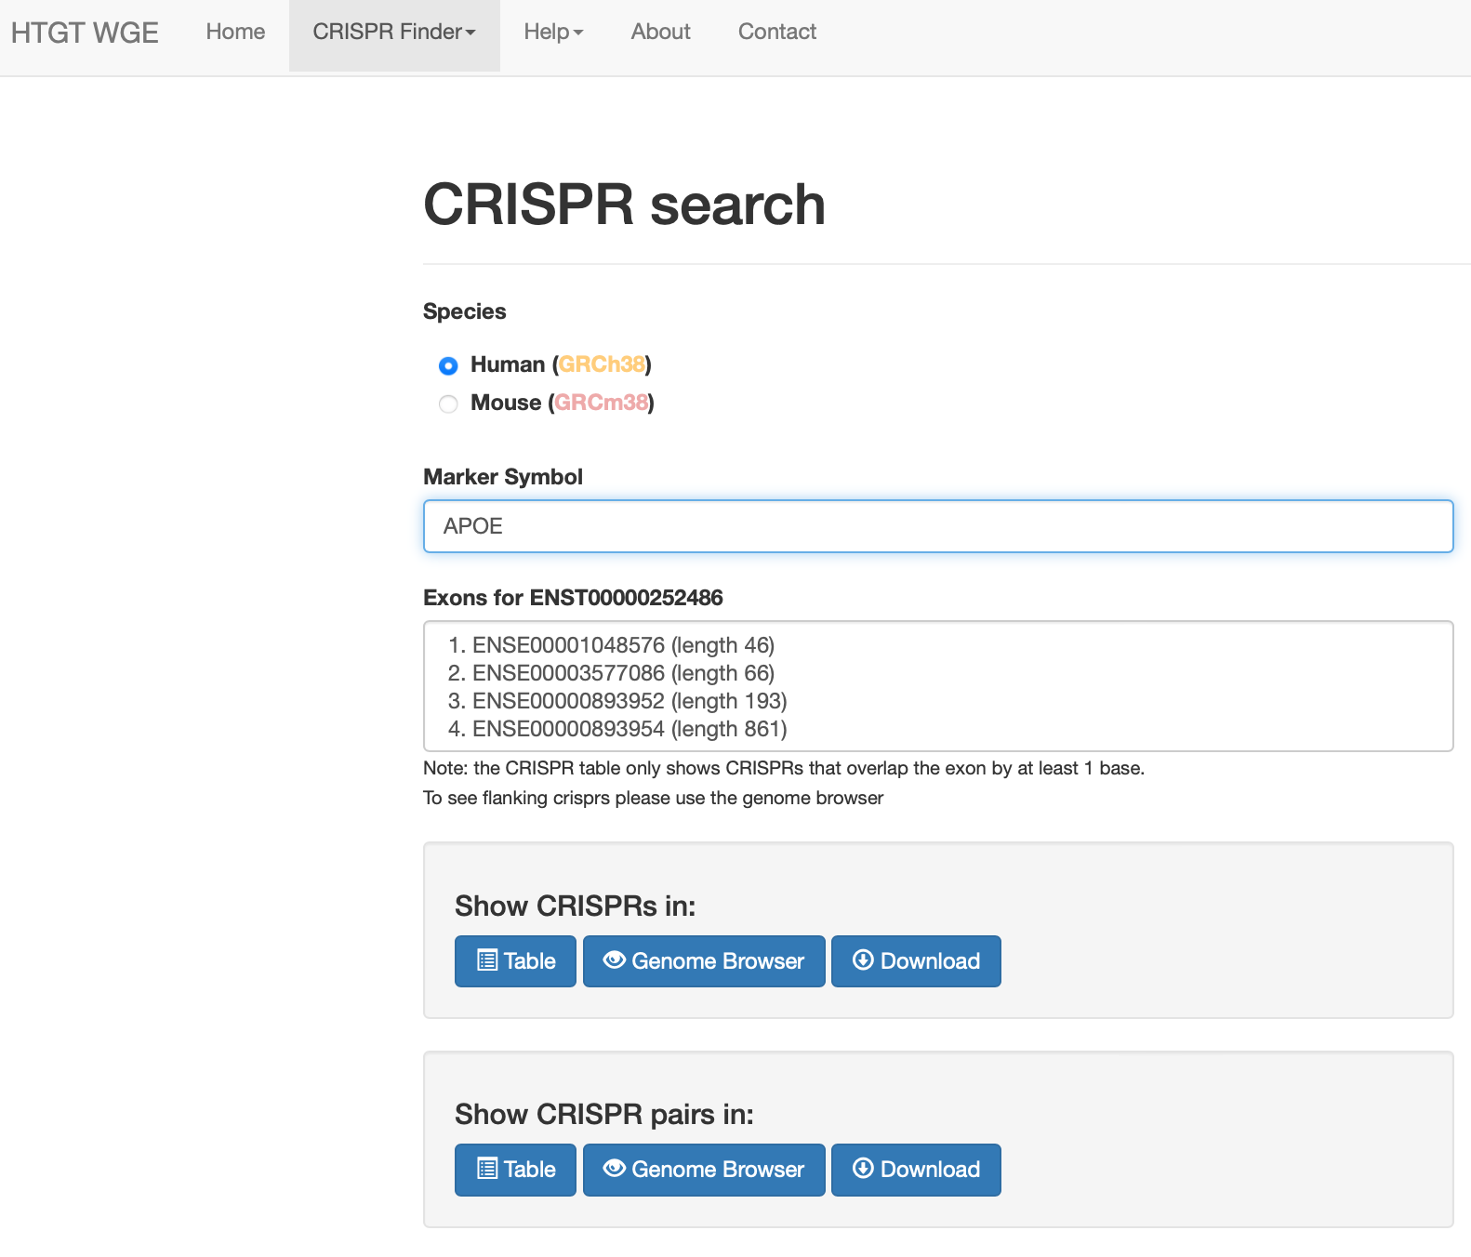
CRISPR Design Process and Tools
Generate a list of sgRNAs rather than selecting them individually.
Notes:
It populates the known exons for the gene, and then you need to select the exon which you want to create guides for.

Slide 55
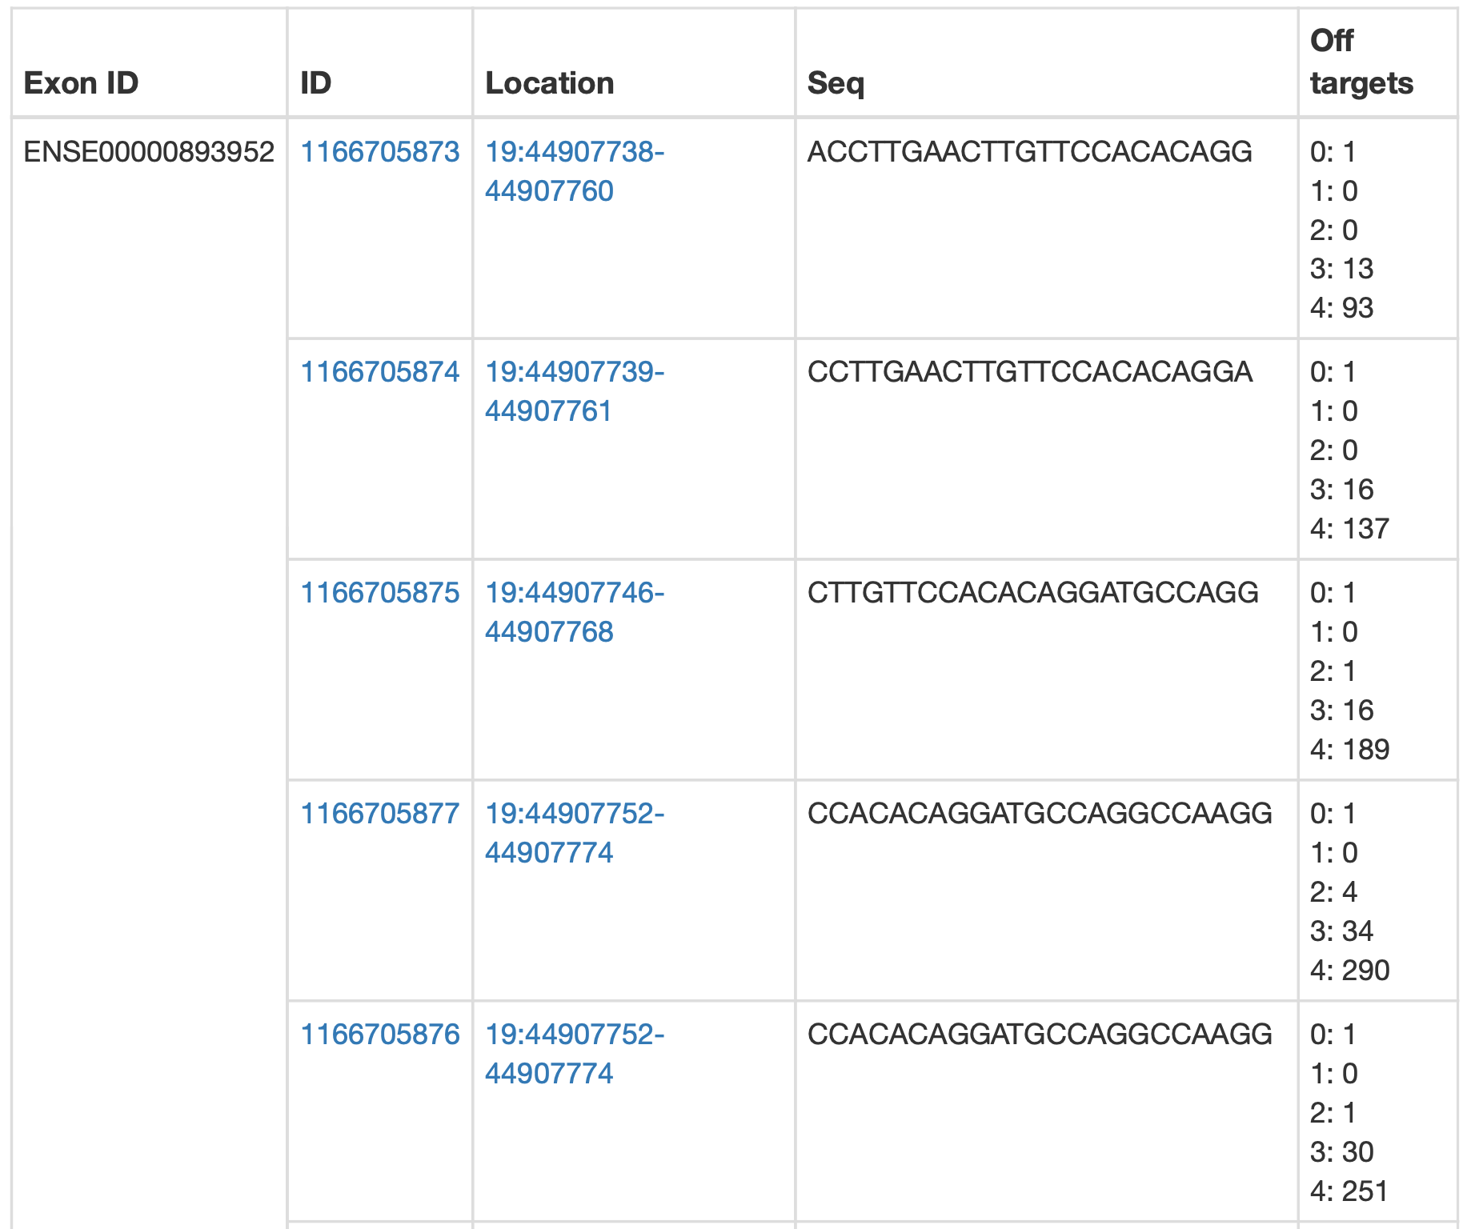
CRISPR Design Process and Tools
Notes:
The list is in order of location in the exon from 5’ to 3’. Again this is an ubiased list of guides.

Slide 56
CRISPR Design Process and Tools
Required for confirming correct targeting or frameshifts
If there are no unique genotyping primers available, then go back to the previous
stages and select an alternative gRNA and/or target region
Step 4: Design genotyping primers
https://www.ncbi.nlm.nih.gov/tools/primer-blast/
Some gRNA design tools have a built-in primer design tool.
Notes:
Primer-BLAST requires an input FASTA sequence, with the flanking sequence from
either side of the CRISPR cleavage site.

Slide 57
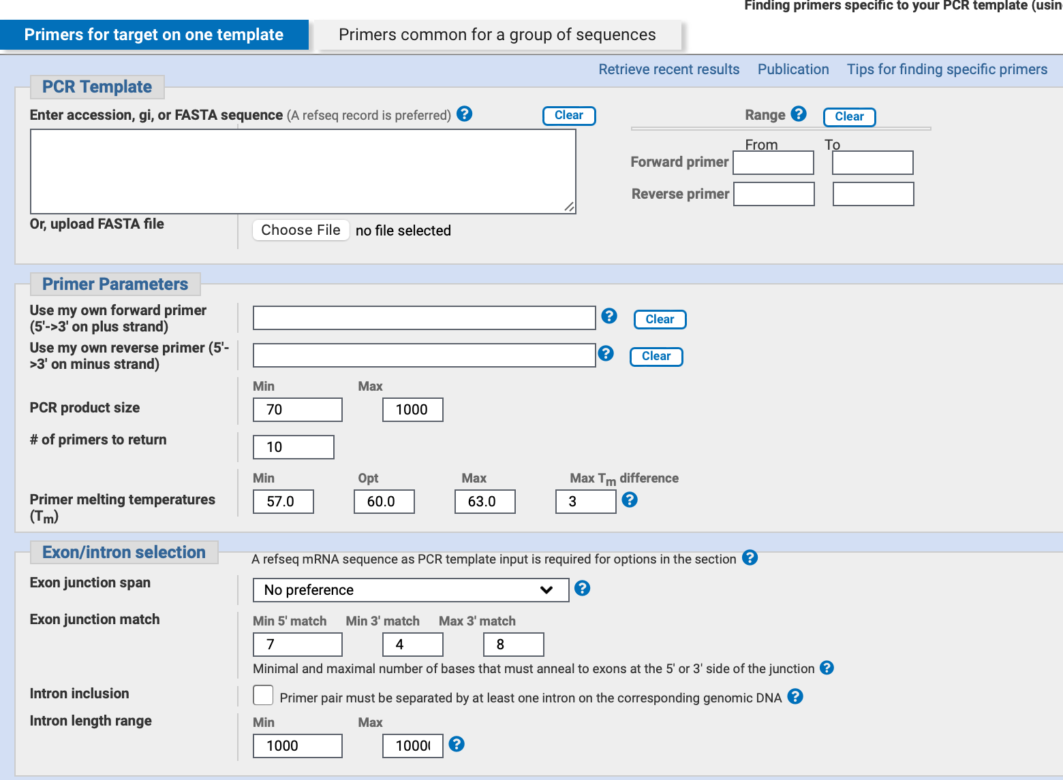
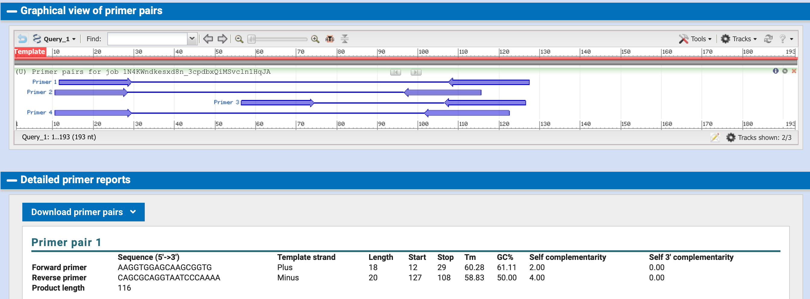
CRISPR Design Process and Tools

Slide 58
Other sgRNA Design Tools
Notes:
Pg 69 of notes Summary of data you will get and how scoring works.
p60-61 notes

Slide 59
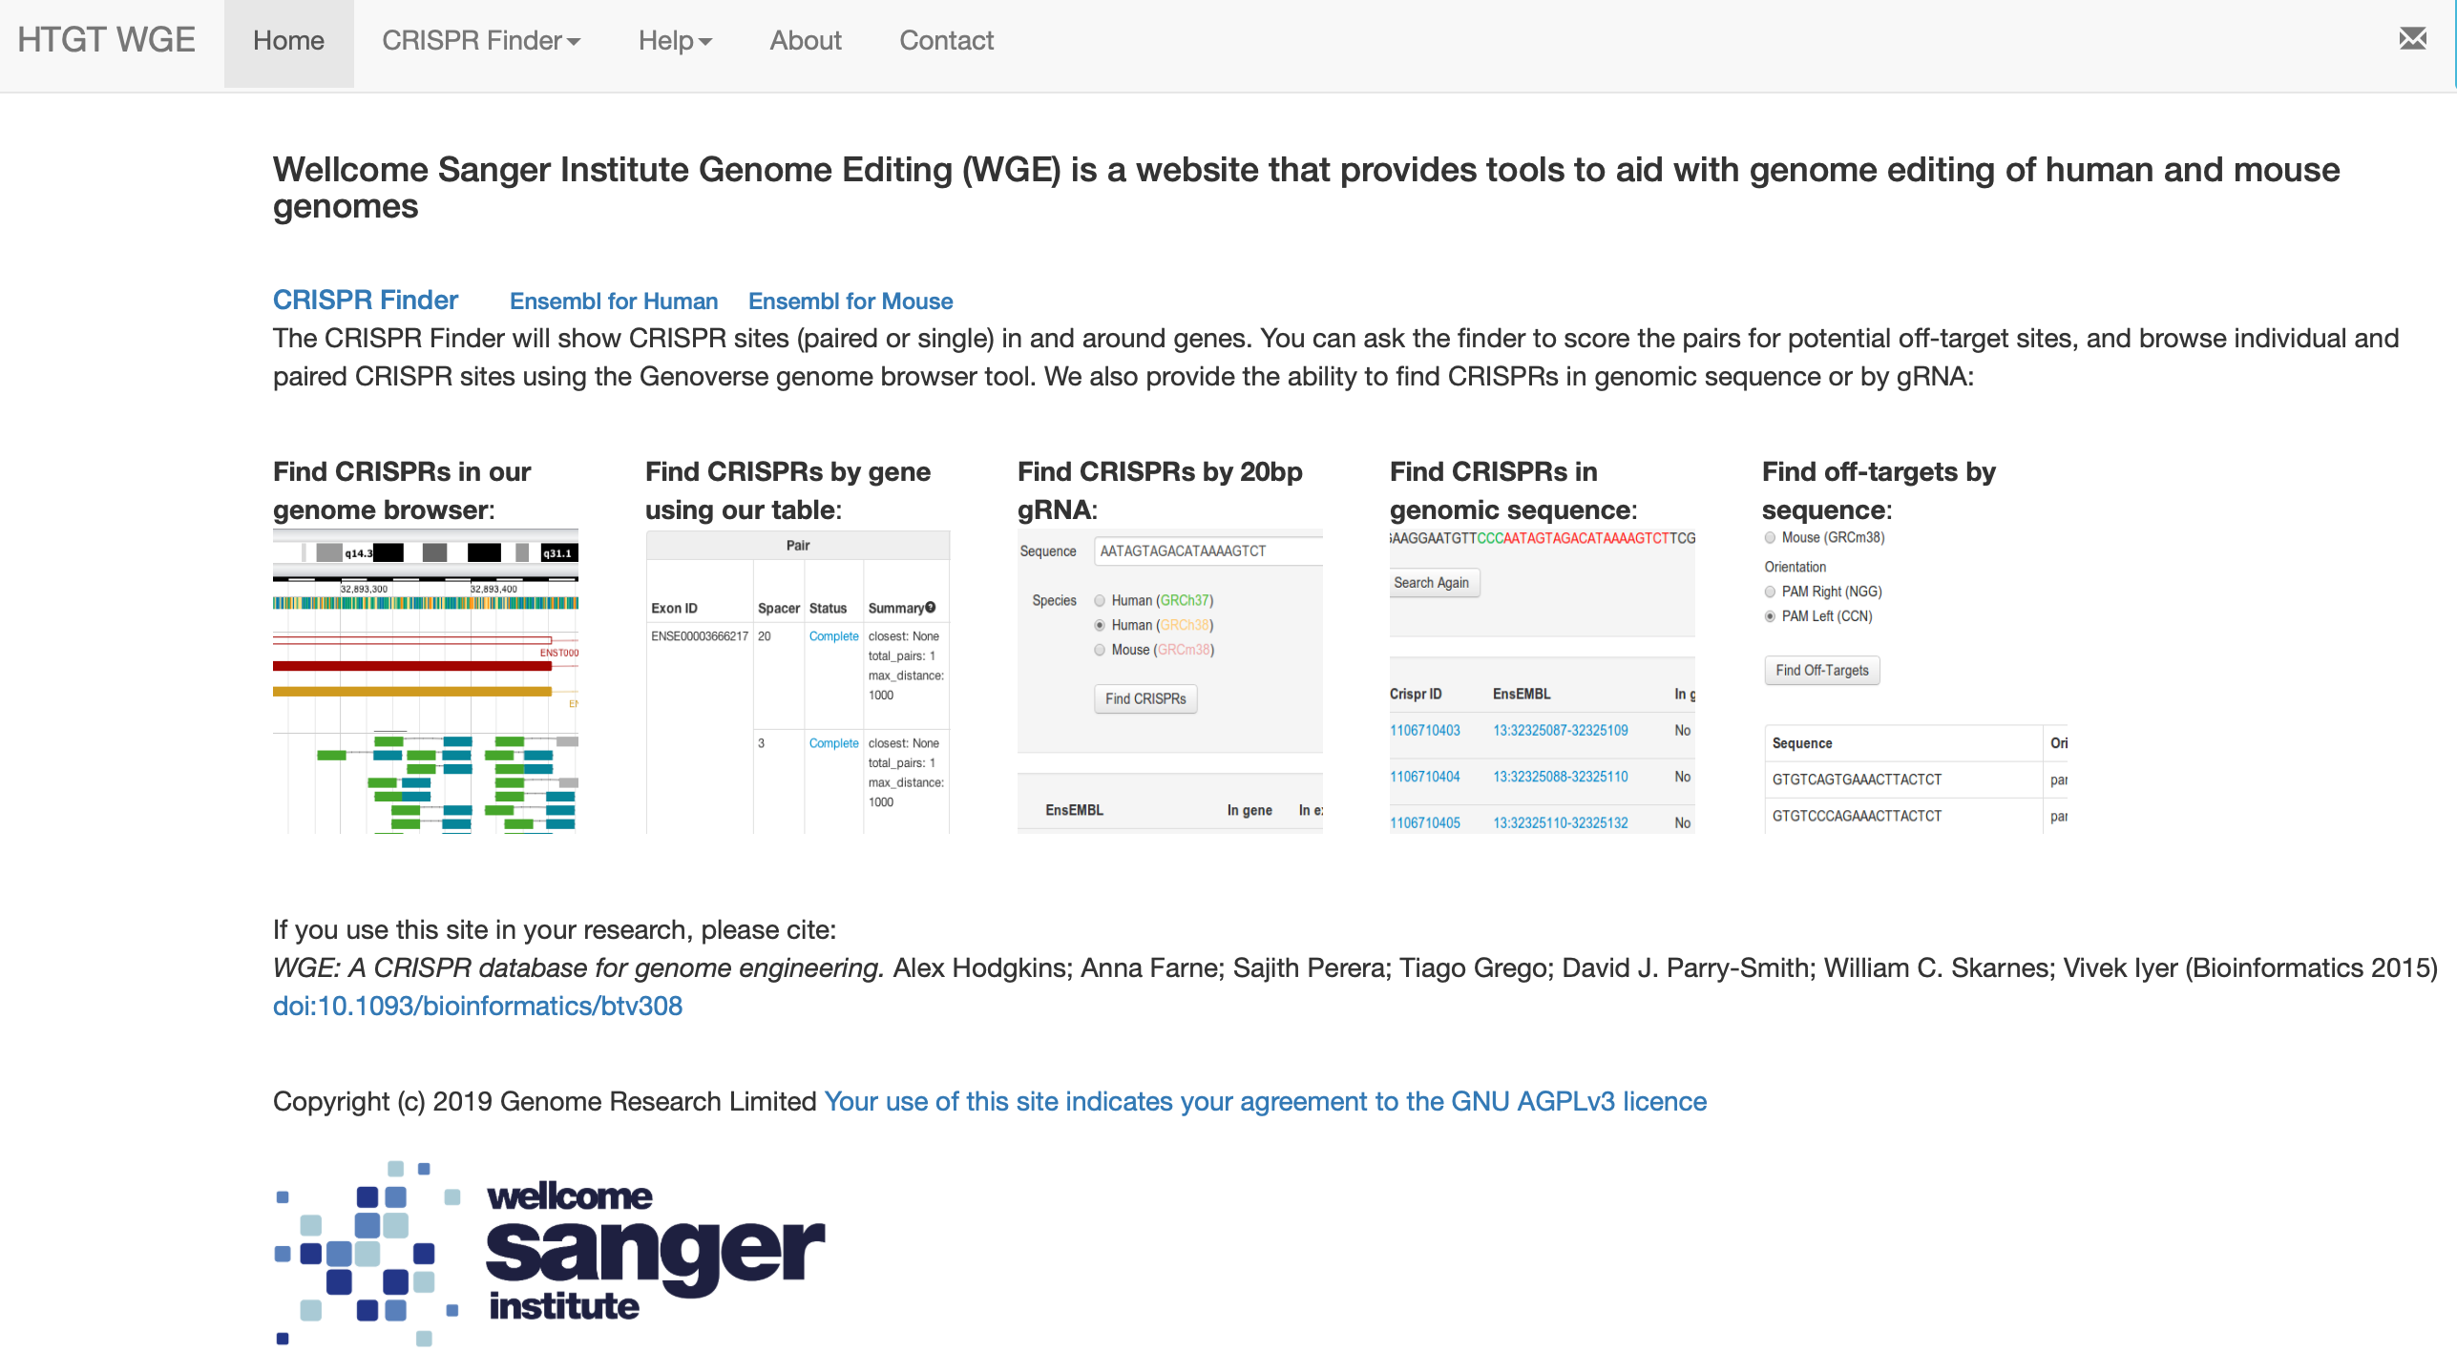
sgRNA Design Tools
Other tools
Notes:
Other ways to design gRNA using the Wellcome Sanger Institute Genome Editing (WGE) design suite.

Slide 60
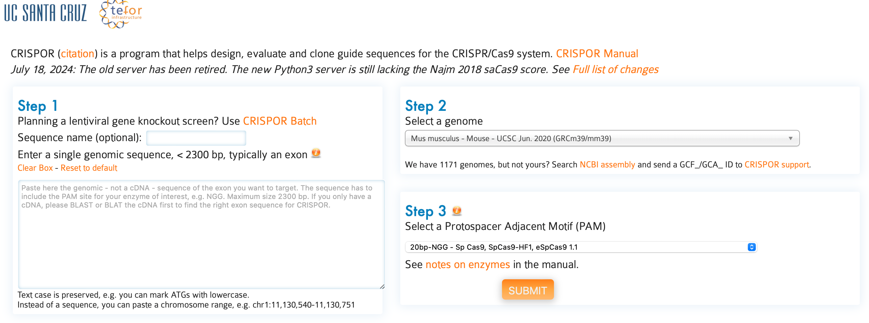
sgRNA Design Tools
Other tools
Notes:
This software has a wide range of user defined options including the reference genome and PAM sequence.
Designs primers for cloning sgRNA into plasmids or for In vitro transcription downstream of a T7 promoter. It also provides primers for amplification of genomic DNA surrounding the gRNA target site.

Slide 61
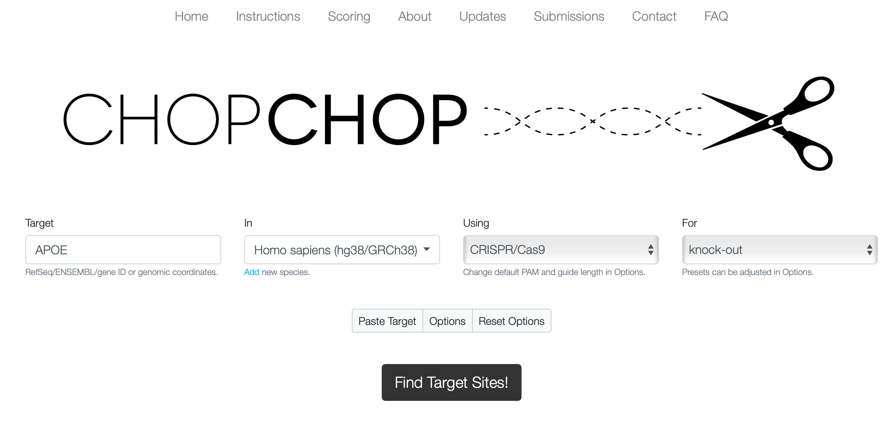
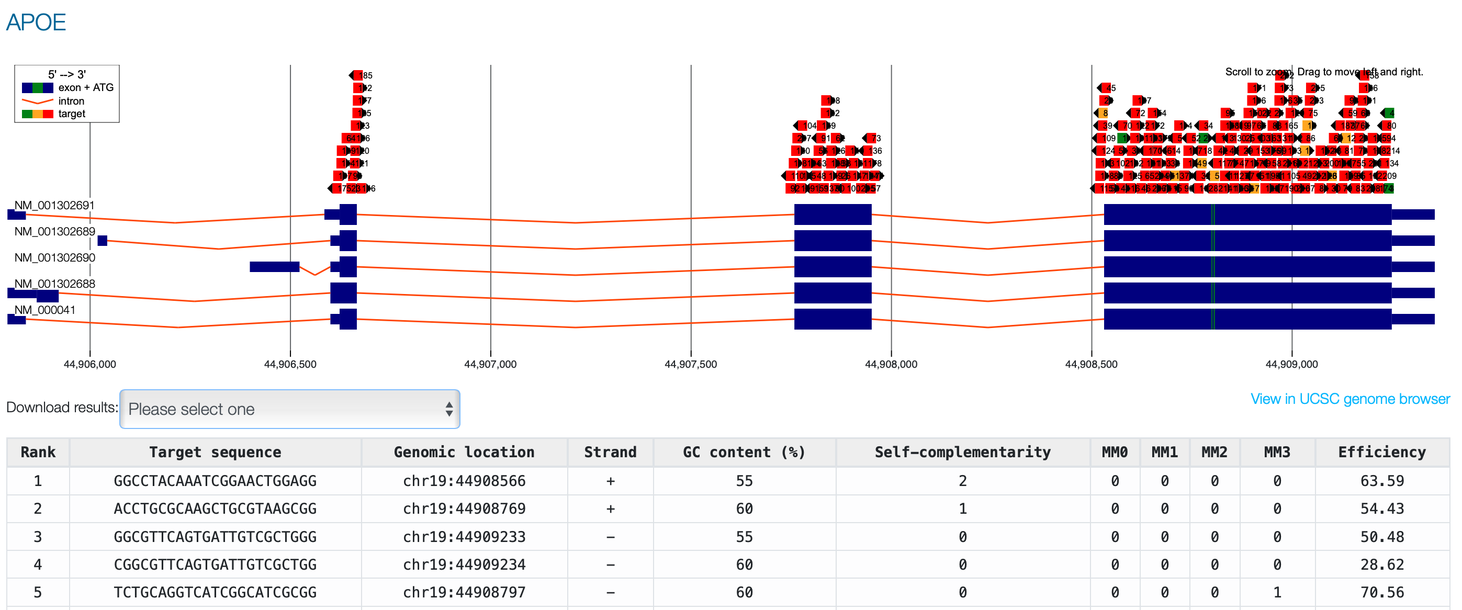
sgRNA Design Tools
Other tools
Notes:
CHOP CHOP has the genotyping primer design built-in.

Slide 62
Thank you
Guided computational practical: Genes and Genomes 07/10/2024

